Slide 1
GCSE ART & DESIGN EXTERNALLY SET TASK (EXAM)
OBJECTIVES
To have a clear understanding of the project brief.
To generate a wide range of ideas using a wide range of sources.

Slide 2
Initial Ideas Research Task
TASK: Use the internet to research your chosen theme.
TIPS
Use Google images and use Pinterest.
Use sensible extended searches
If you have chosen ‘Music’ don’t just search Music art/photography/textiles.
Keep your ideas really broad at this stage
Have photos and art work.
Include images which you like, even if you don’t plan on doing something like it at this point
Get lost in your searches!
WHAT NOT TO DO
Don’t think ‘I know what I am going to do’.
Don’t think ‘for my final piece I am going to…’
Don’t research one idea.
Don’t choose lots of images which are too similar.
ENJOY EXPLORING YOUR CHOSEN TOPIC!

Slide 3
GCSE ART & DESIGN EXTERNALLY SET TASK (EXAM)
OBJECTIVES
To develop skills in presentation, taking inspiration from your chosen images.
To generate work which has been inspired by your research.

Slide 4
GCSE EXAM 2025 – final 40% of your GCSE
How to annotate your initial ideas
Explain why you have chosen the topic/theme.
Explain why you have selected the images on your sheet.
What do you like about them? Why?
How could you create work using these techniques?
Explain what your initial idea is (the examiner is not a mind reader)
State your intentions.. what are you intending to do next?
Initial Ideas - ART
What does an 4/5 grade initial ideas sheet include?
A range of ideas
Clear annotations
Range of media used
Examples of your own work
Titles (theme & Initial Ideas)
Careful presentation
What does an 8/9 grade initial ideas sheet include?
A wide range of ideas
Clear and critical annotations
Confident use of media
Examples of your own work
A copy of one of your chosen images
Titles (theme & Initial Ideas)
Professional presentation linking to your theme/ideas
HINTS AND TIPs
Do not think about your final piece at all!
Be original!
Keep your options open!
Research in depth and keep searching.
Google Images and Pinterest are fantastic resources
Presentation
Think about layout
Cut edges carefully and neatly (use paper trimmers)
Mount work neatly (straight)
Layer images and text/titles
If preparing a background for your sheet then think about it first, is it suitable to your theme/topic?
DEADLINE – Thur 23rd Jan (end of lesson)

Slide 5
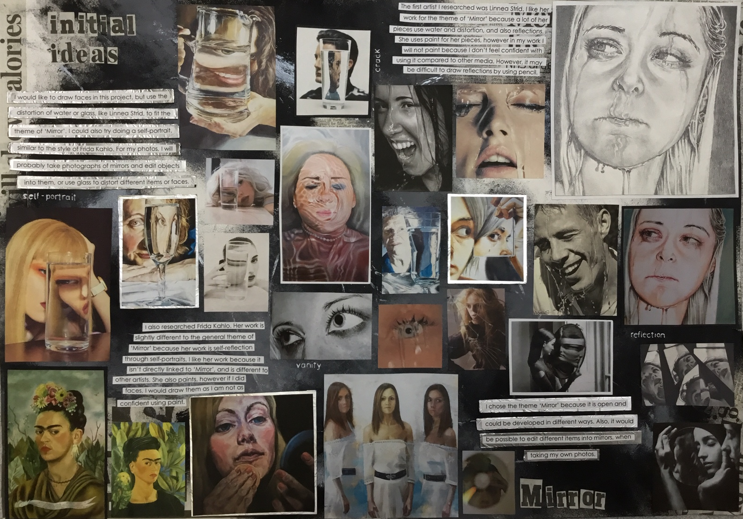
Wide range of images
Titles
Copy of one of images
What does my initial ideas page need?
Written work
Key Words
Appropriate presentation

Slide 6
GCSE ART & DESIGN PPE/EXTERNALLY SET TASK (EXAM)
OBJECTIVES
To carry out some in depth research into a chosen artist/culture/theme.
To be able to evaluate and analyse the work of an artist.
To develop your understanding of your chosen artist, taking inspiration from their work.

Slide 7
Artist Research
TASK: Find an artist and research them.
TIPS
Use Google images
Use Pinterest
Don’t worry if they are not well known
Read about your artist, the more you know the better your work will be.
You could use more than one artist.
Find examples of work which relate to the theme and ones which you like
Select the highest quality images
WHAT NOT TO DO
Don’t search using questions like ‘when was ……… born’
Don’t copy and paste
Don’t use loads of pointless facts
ENJOY RESEARCHING YOUR ARTIST(S)

Slide 8
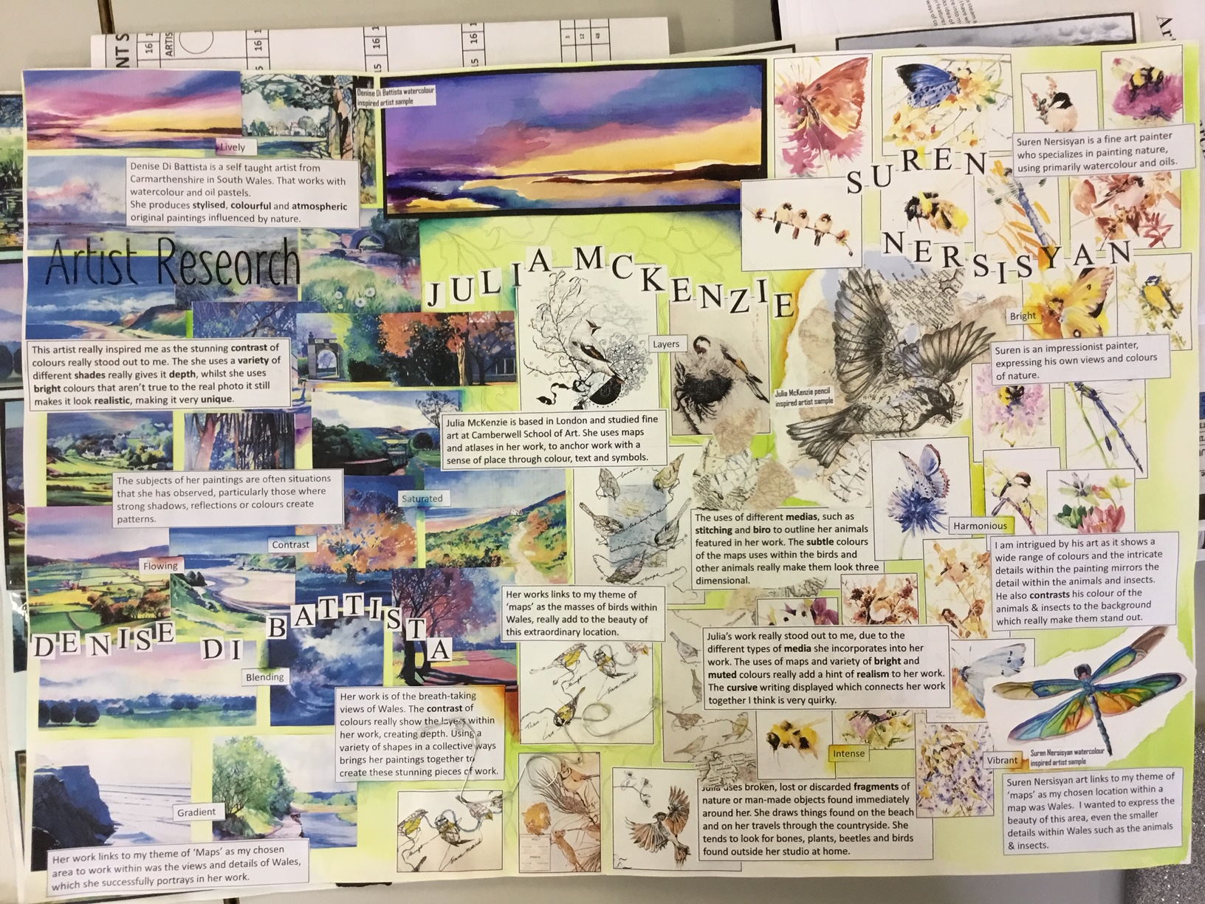
Facts
Wide range of images
Titles
Own Artwork
Personal Response
Keywords
Appropriate presentation

Slide 9
GCSE EXAM 2025 – final 40% of your GCSE
HINTS AND TIPS
Select an artist who inspires you.
Select someone who works in a way that you would like to.
Don’t waffle when writing about artists
Make your written work as visual as you can (highlight key words).
Artist Research - ART
What does a grade 5 artist research sheet include?
Basic factual information
Your own personal response to the artists work
High quality printed images
A direct copy of a piece of work
Titles – Artist research, artist name and theme
Careful presentation linked to your artist
What does a grade 7+ artist research sheet include?
A short biography
A critical and in depth personal response to the work
High quality printed images
A direct copy of a piece of work
At least one piece of work which has been inspired by your artist
Titles – Artist research, artist name and theme
Carefully thought out presentation and media used with skill
Presentation
Think about layout and balancing your sheet.
Include all 3 titles.
Ensure that your sheets link in terms of presentation (to your theme and to each other).
DEADLINE Thurs 6th Feb

Slide 10
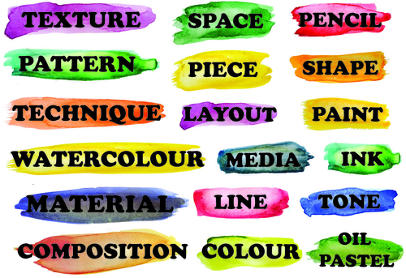
Writing about artists
DESCRIBE IT…
What do you see?
Describe the art work in detail.
How would you describe the colours/shapes/size of it?
How do you think it was made?
FACTFILE
Who is the artist…?
When were they born? When did they die?
Where are they from?
Where were they educated?
Who/what inspired them?
Are they associated with any particular art movement?
Are they linked with other artists?
Why are you looking at this artist?/ How do they relate to your theme?
RELATE IT…
What does the work remind you of? Why?
What interests you most about this work? Why?
ANALYSE IT…
What can you tell me about the colours used?
How is the image composed Using the Formal Elements? Line, colour, tone, pattern, shape, form and texture.
How does the art make you feel? Why?
What do you think is the most important part of this art? Why?
INTERPRET IT…
What title would you give the work and why?
What do you think is happening in this work?
What do you think the meaning of the work is and how did you come to think this?
Remember
Type and print written work, use text boxes, keep to a theme, colour font. Print out and save all work!
EVALUATE IT…
What do you think is good about this work and what do you think is not so good? Why do you think this?
What do you think is memorable about this piece of art?
How can this piece of work inspire your work?
What have you learnt from this research?

Slide 11
Section 1 - Fact file
• Who is the artist…?
Sentence Starter: The artist that I am studying is...
• When were they born?/When did they die?
Sentence Starter: He/she was born on... and died on...
• Where are they from?
Sentence Starter: He/she was born in...
• Where were they educated?
Sentence Starter: He/she was educated at...
• Who/what inspired them?
Sentence Starter: He/she is inspired by...
• Are they associated with any particular art movement?
Sentence Starter: Their work is associated with...
• Are they linked with other artists?
Sentence Starter: They have worked alongside...
• Why are you looking at this artist?/ How do they relate to your theme?
Sentence Starter: This artist/their name relates to my work because...
Section 2 – Describe it
Sentence Starter: In the art work I can see…
Sentence Starter: I would describe the colours as…, the shapes as…
Sentence Starter: The work was made using… OR The art work is a… created using…
Section 3 - Relate it
Sentence Starter: This work reminds me of... because...
Sentence Starter: The thing that interests me the most about this work is... because...
Section 4 - Interpret it
Sentence Starter: The work reminds me of… because…
Sentence Starter: I think that…
Sentence Starter: I think that the meaning behind this work is…
Section 5 - Analyse it
Sentence Starter: The colours in this work are... which suggests/means...
Sentence Starter: This work is made up of...
Sentence Starter: This work makes me feel... because...
Sentence Starter: In my opinion the most important part of the work is...
Section 6 - Evaluate it
Sentence Starter: I think that... because...
Sentence Starter: The most memorable thing about this work is...
Sentence Starter: This would could inspire me to...
Sentence Starter: Following my research into... I have learnt that...
Sentence Starters
Writing about artists

Slide 12
GCSE ART & DESIGN EXTERNALLY SET TASK (EXAM)
OBJECTIVES
To generate a series of observations using a range of techniques.
To take a series of photos which are relevant to your ideas and intentions.
To experiment with ICT to create a series of edits.
To produce high quality observations.

Slide 13
GCSE EXAM 2025 – final 40% of your GCSE
DEADLINE – Thur 13th March
Observations - ART
Contents of your sheet:
Your own photographs related to your theme and ideas.
Your edits created using your photos (PowerPoint, cut and stick, Apps etc.)
Secondary images if necessary.
Drawings from your own photos.
Use a range of media (pencil, pen, ink, paint, collage, pastels, fine liner, mixed media etc)
Titles – your chosen theme and Observations
Evaluations – what have you done? what went well? What could you improve? What are your intentions?
Presentation – stick to your theme!

Slide 14
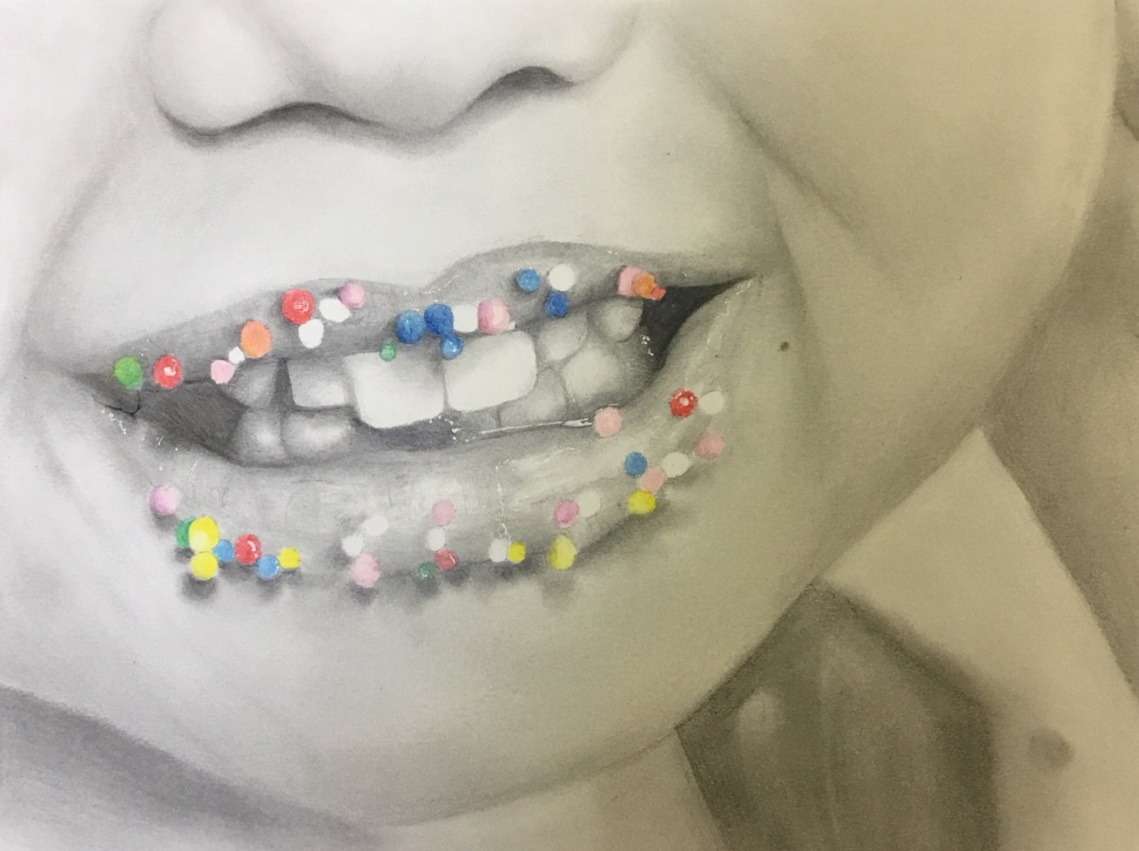
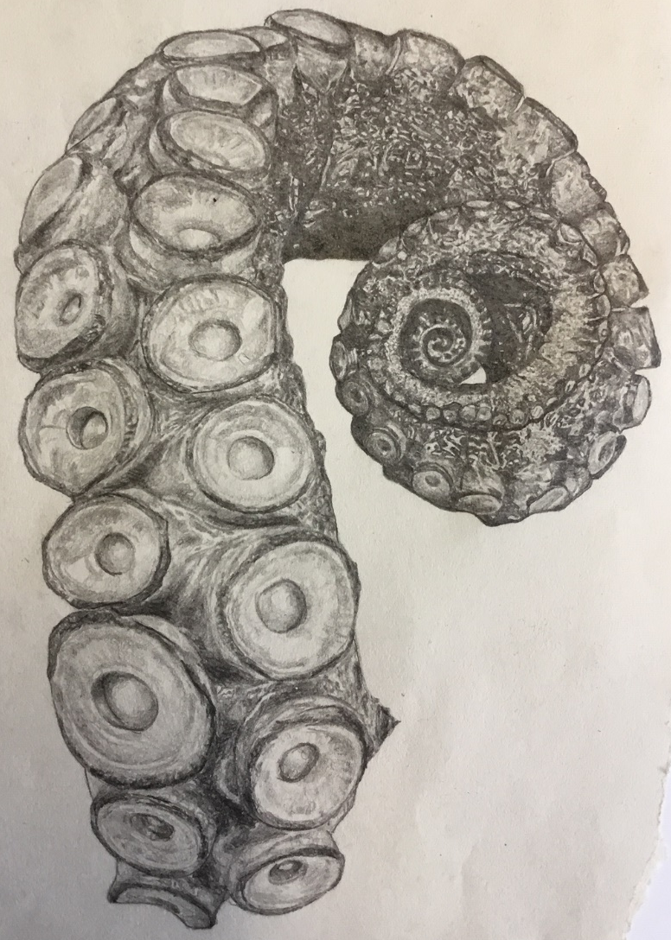
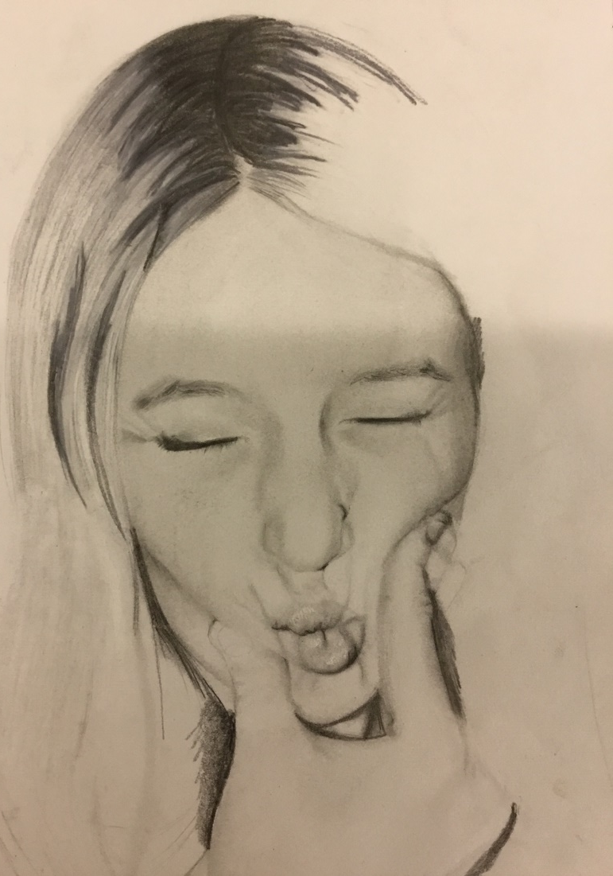
YOU NEED TO PRODUCE DRAWINGS/PANTINGS/ARTWORK from photos (primary and secondary sources) NOT from images of other people’s art work, this is now about you developing your own work!

Slide 15
GCSE ART & DESIGN EXTERNALLY SET TASK (EXAM)
OBJECTIVES
To develop ideas using artist links and observations.
To experiment with a wide range of media and materials.

Slide 16
GCSE EXAM 2025 – final 40% of your GCSE
Development of Ideas- ART
What do you need to do?
Start to generate ORIGINAL art work related to all of your work so far
Draw/paint/generate work from your photos.
Draw/paint/generate work from your edits.
Create a collage to work from.
Take inspiration from your research/artists.
Combine images from primary and secondary sources.
Draw/paint/generate work from an artist’s work (copying)
Repeat the work you have already done.
Create something random which has come from nowhere.
DEADLINE – Thurs 27th March

Slide 17
GCSE ART & DESIGN EXTERNALLY SET TASK (EXAM)
OBJECTIVES
To develop composition ideas for a final outcome.
To experiment with a wide range of media and materials.

Slide 18
GCSE EXAM 2025 – final 40% of your GCSE
What do you need to do?
Start to generate ORIGINAL art work related to all of your work so far
Development of Ideas- ART
What does your sheet need?
Examples of your own work.
The images that you are working from, this could be collages or photos.
Artist links (images which have inspired your work)
Annotations
Presentation – linked to other sheets
ANNOTATIONS
What are you doing? Why are you doing it?
Where have your ideas come from?
What/who has inspired your work?
Is your work successful? Why? What are you going to change?
What media have you used? Why? Has it worked?
How could your work develop further?
What are your intentions?
Presentation
Think about layout and balancing your sheet.
Include both titles.
Ensure that your sheets link in terms of presentation (to your theme and to each other).
DEADLINE
Thur 27th March

Slide 19
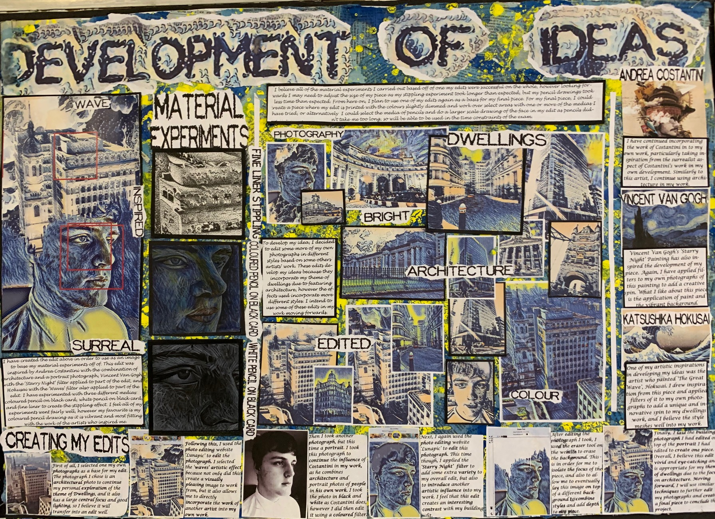
Collage to work from – created digitally
Edits created to experiment with ideas
Media experiments
Edit screenshots

Slide 20
GCSE ART & DESIGN EXTERNALLY SET TASK (EXAM)
OBJECTIVES
To produce a detailed plan for your exam.
To consider artist links, timing and media.

Slide 21
Planning your final piece/exam
Task: To create an a3 sheet which details your plans for the 10 hour exam
Requirements
Deadline
10th April(exam day 1)
Your composition
This could be a collage, design, drawing, photograph(s)
Titles
Final piece plan and chosen theme
Artist links – image(s)
Images of the work which has influenced your project/piece
Chosen media trial
A section of your final piece done in your chosen media/material
Annotations
An explanation of your final piece including:
What are you planning on doing? which media? who inspired it? How? Describe the process and refer back to the theme, how does your piece answer the question/starting point.
25% of the marks for Research
25% of the marks for observations
25% of the marks for use of media
25% of the marks for the exam!

