Slide 1
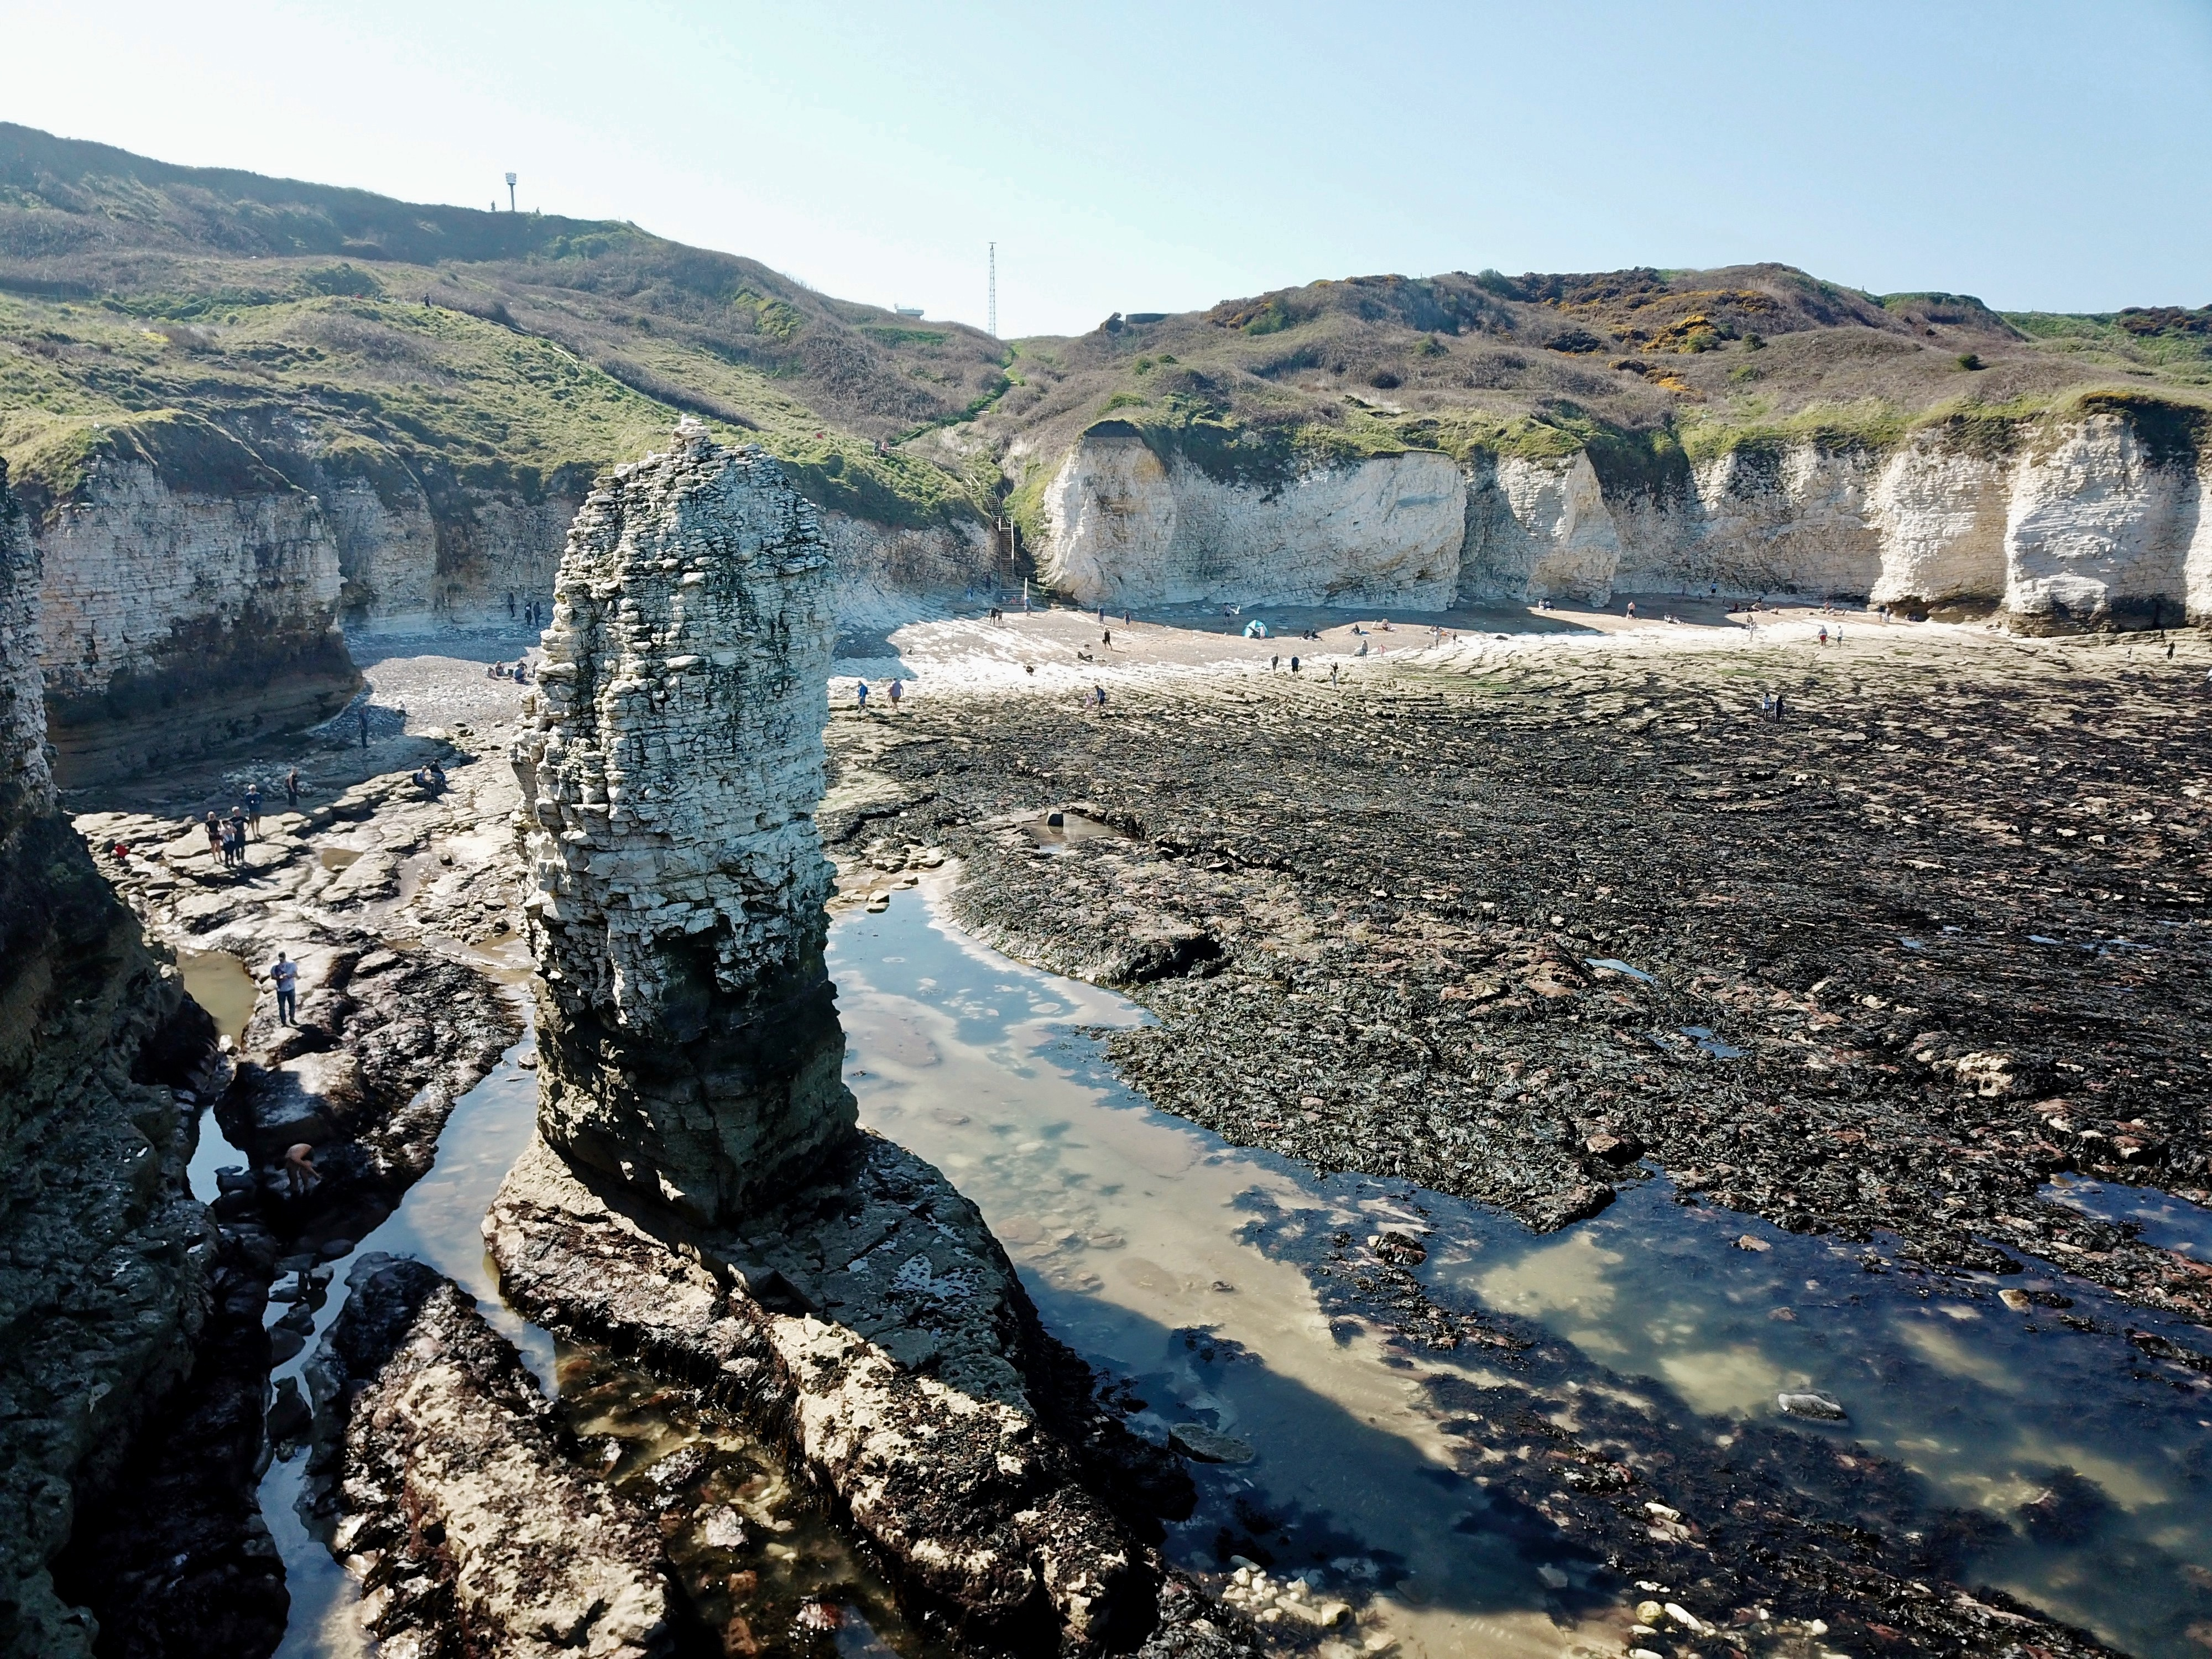
Coastal Landforms of erosion
Re-Write it
Read the Student answer to the question below.
Figure 1. Selwicks Bay, Flamborough
Q. Explain how different coastal landforms are created by erosion. Use Figure 1 and your own understanding. (6 marks)
A. Figure 1 shows a stack. This will have once been attached to the headland as an arch. However, the arch collapsed leaving behind a stack. Figure 1 also shows a wave-cut platform. This used to the cliffs however they have been eroded back leaving behind the exposed platform. There are also cliffs and beaches in the image.
Read the marking guidance to the question below. Identify the level of the answer above. Next, identify the positive features and suggest improvements that could be made.
Level | Marks | Description
3 (Detailed) | 5-6 | AO2 Shows thorough geographical understanding of processes and landforms associated with coastal erosion. AO3 Demonstrates thorough application of knowledge and understanding in analysing the landforms shown in Figure 1.
2 (Clear) | 3-4 | AO2 Shows some geographical understanding of processes and landforms associated with coastal erosion. AO3 Demonstrates reasonable application of knowledge and understanding in analysing the landforms shown in Figure 1.
1 (Basic) | 1-2 | AO2 Shows limited geographical understanding of processes and landforms associated with coastal erosion. AO3 May include limited application of knowledge and understanding in analysing one or more landforms shown in Figure 14.
 | 0 | No relevant content
The command word “explain” is used, which means to provide a reasoned account of the ways that animals and plants adapt to the tropical rainforest.
Improvements
Positive
Identify key geographical terms that Should be included to improve the answer.
Glossary

Slide 2
Coastal Landforms of erosion
Re-Write it
Attempt the question below yourself. Write like a geographer – use key geographical terms and make sure you Explain (give reasons for) your answer.
Explain how different coastal landforms are created by erosion. Use Figure 1 and your own understanding. (6 marks)
Figure 1. Selwicks Bay, Flamborough
Figure 1. Selwicks Bay, Flamborough

Slide 3
Coastal Landforms of erosion
Re-Write it
Attempt the question below yourself. Write like a geographer – use key geographical terms and make sure you Explain (give reasons for) your answer.
Explain how different coastal landforms are created by erosion. Use Figure 1 and your own understanding. (6 marks)
Figure 1. Selwicks Bay, Flamborough
Figure 1 shows an exposed wave-cut platform. The sea attacks a weakness in the base of the cliff. For
example, this could be a joint in chalk. A wave-cut notch is created by erosional processes such as hydraulic
action and abrasion. As the notch becomes larger the cliff becomes unstable and collapses as the result of
gravity. The cliff retreats inland. The material from the collapsed cliff face is eroded and transported away.
This leaves a wave-cut platform. The process repeats over time. In addition to this, figure 1 also shows a
coastal stack. A series of processes led to the formation of the stack. Firstly, the sea has attacked the foot of
the cliff and eroded areas of weakness such as joints and cracks, through processes of erosion such as
hydraulic action, wave pounding, abrasion and solution. Gradually these cracks became larger, developing
into small caves. Further erosion widened the cave and where the fault lines run through the headland, two
caves then eroded into the back of each other forming an arch, passing right through the headland. A
combination of wave attack at the base of the arch, and weathering of the roof of the arch (by frost, wind
and rain), weakened the structure until the roof of the arch collapsed inwards leaving a stack, a column of
rock which stands separate from the rest of the headland. Eventually, the base of the stack will erode leading
to the formation of a stump.

