Slide 1
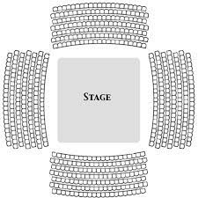
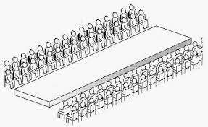
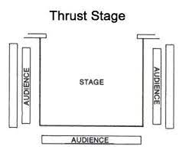
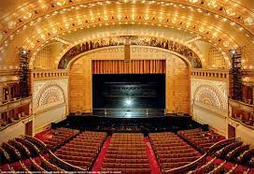
Different Stage Types
Theatre in the Round
Promenade
A performance where the audience are allowed to walk around – perhaps from scene to scene or to different areas.
Traverse Stage
Proscenium Arch
End- on
Like the performance space in here: might have no raised stage; however, the audience sit at one end and the performance takes place at the other.
Thrust Stage

