Slide 1
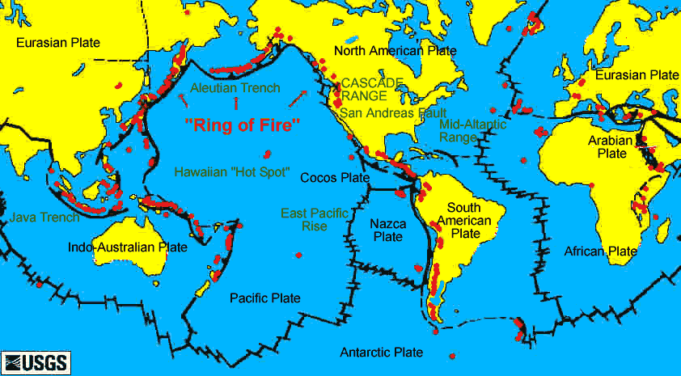
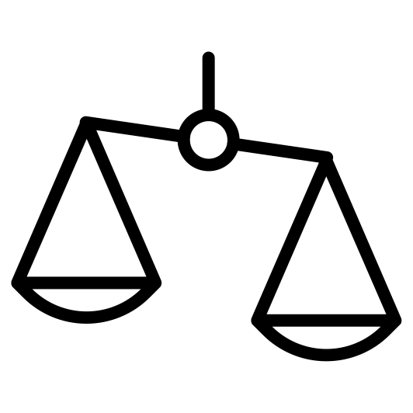
Distribution of Volcanoes
Re-Write it
Read the Student answer to the question below.
Q. Describe the distribution of volcanoes shown in figure 1. (2 marks)
Volcanoes are found all over the world. This includes in North America, South America, Africa and Asia.
Figure 1. The global distribution of active volcanoes
Read the marking guidance to the question then identify the positive positive features and suggest improvements that could be made.
Credit statements about distribution of volcanoes using information on the map. No credit for simply listing continents or places where volcanoes are found. AO4 = 2 marks
Improvements
Positive
Identify key geographical terms that Should be included to improve the answer.
Glossary

Slide 2
Distribution of Volcanoes
Re-Write it
Attempt the question below yourself. Write like a geographer – use key geographical terms and make sure you Describe (Say what something is like) for your answer.
Q. Describe the distribution of volcanoes shown in figure 1. (2 marks)
__________________________________________________________ __________________________________________________________
__________________________________________________________ __________________________________________________________
Figure 1. The global distribution of active volcanoes
Credit statements about distribution of volcanoes using information on the map. No credit for simply listing continents or places where volcanoes are found. AO4 = 2 marks

Slide 3
Distribution of Volcanoes
Re-Write it
Attempt the question below yourself. Write like a geographer – use key geographical terms and make sure you Describe (Say what something is like) for your answer.
Q. Describe the distribution of volcanoes shown in figure 1. (2 marks)
__________________________________________________________ __________________________________________________________
__________________________________________________________ __________________________________________________________ __________________________________________________________ __________________________________________________________
Figure 1. The global distribution of active volcanoes
The distribution of volcanoes is not random and they do have a relationship with
close proximity to plate margins (1).
They occur in narrow bands along plate
margins. (1)
There is a chain of volcanoes occurring along the Ring of Fire
surrounding the Pacific Ocean (1).
There are anomalies, as some occur in the
middle of plates in 'hot spots' and not at plate margins (1). Volcanoes are found
at constructive and destructive plate margins (1).
Credit statements about distribution of volcanoes using information on the map. No credit for simply listing continents or places where volcanoes are found. AO4 = 2 marks

