Slide 1
1-3 Mark Questions
Command Words
1 mark questions
2-3 mark questions
Name
Calculate
Suggest one…
State
Give
Identify
Describe
Define
Describe
Outline
Calculate
Using figure x and you own understanding suggest how…
Give two
Suggest
You will be awarded one mark for making one clear and accurate point .
You will be awarded either two marks for making two points or two marks for making one point that you have developed.

Slide 2
1-3 Mark Questions
Hazards

Slide 3
1-3 Mark Questions
The Challenge of Natural Hazards
State what is meant by natural hazard. [1 mark]
State what is meant by hazard risk. [1 mark]

Slide 4
1-3 Mark Questions
Tectonic
Hazards

Slide 5
1-3 Mark Questions
The Challenge of Natural Hazards
Define tectonic hazard. [1 mark]
What is an earthquake? [1 mark]

Slide 6
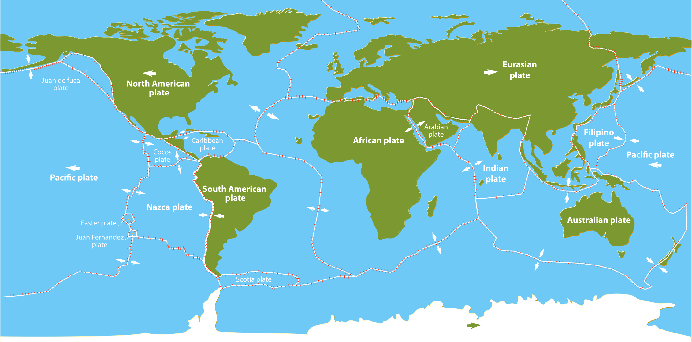
1-3 Mark Questions
The Challenge of Natural Hazards
Study figure 1, a world map showing tectonic plates and their direction of movement. Identify the plate margin labelled A. [1 mark]
Figure 1
A

Slide 7
1-3 Mark Questions
The Challenge of Natural Hazards
Study figure 1, a world map showing tectonic plates and their direction of movement. Identify the plate margin labelled A. [1 mark]
Figure 1
A

Slide 8
1-3 Mark Questions
The Challenge of Natural Hazards
Study figure 1, a world map showing tectonic plates and their direction of movement. Identify the plate margin labelled A. [1 mark]
Figure 1
A

Slide 9
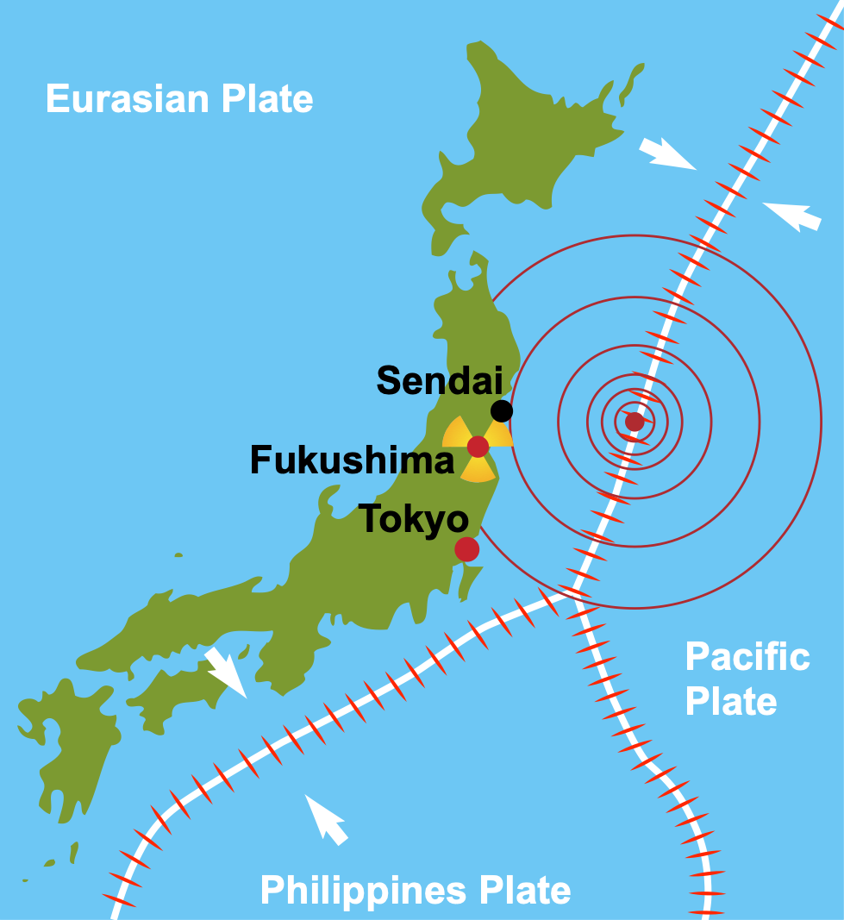
1-3 Mark Questions
The Challenge of Natural Hazards
Study figure 2, a map to show Japan’s tectonic setting. Identify the type of plate
margin between the Eurasian and Pacific plates. [1 mark]
Figure 2

Slide 10
1-3 Mark Questions
The Challenge of Natural Hazards
Study figure 2, a map to show Japan’s tectonic setting. Suggest one tectonic hazard that is likely to occur near the plate margins shown in figure 2. [1 mark]
Figure 2

Slide 11
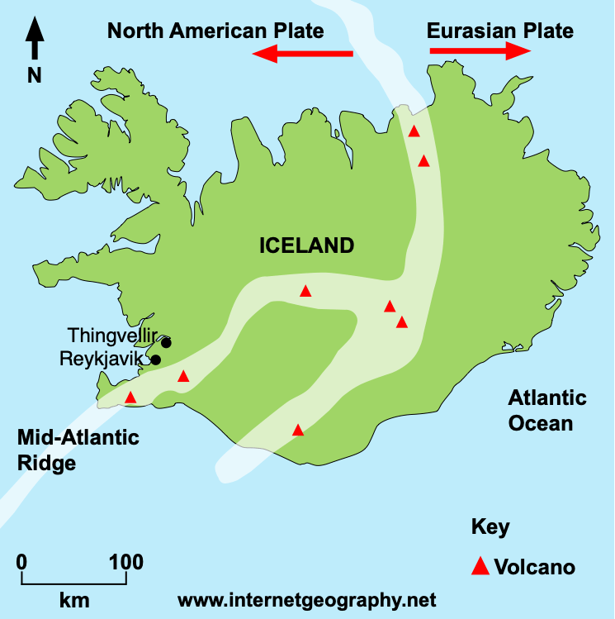
1-3 Mark Questions
The Challenge of Natural Hazards
Study figure 3, a map to show Iceland’s tectonic setting. Identify the type of plate margin between the Eurasian and North American plates. [1 mark]
Figure 3

Slide 12
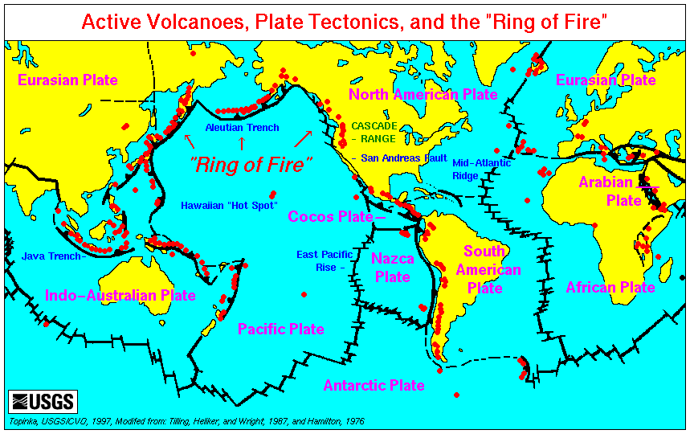
1-3 Mark Questions
The Challenge of Natural Hazards
Study figure 4, a map to show the global distribution of active volcanoes in relation to tectonic plates. Give two characteristics of the distribution of volcanoes. [2 marks]
Figure 4

Slide 13
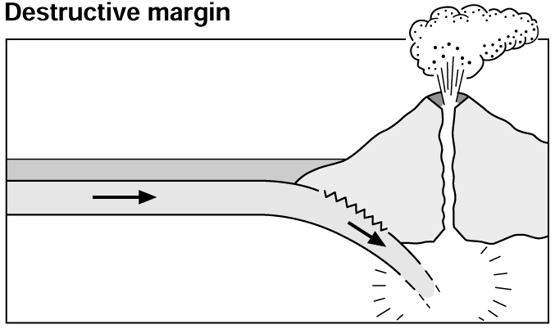
1-3 Mark Questions
The Challenge of Natural Hazards
Study figure 5, a tectonic plate margin. Identify the type of plate margin shown in figure 5. [1 mark]
Figure 5

Slide 14
1-3 Mark Questions
The Challenge of Natural Hazards
Study figure 5, a diagram to show the characteristics of a destructive plate margin. Suggest two tectonic hazards that are likely to occur at a destructive plate margin. [2 marks]
Figure 5

Slide 15
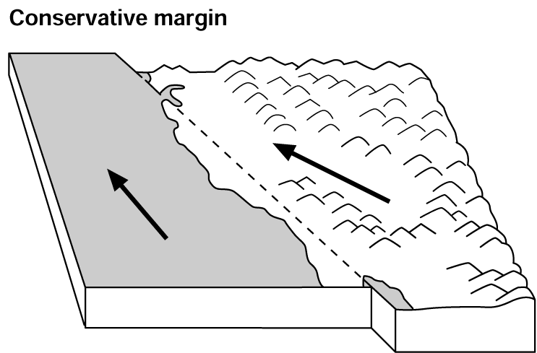
1-3 Mark Questions
The Challenge of Natural Hazards
Study figure 6, a tectonic plate margin. Identify the type of plate margin shown in figure 6. [1 mark]
Figure 6

Slide 16
1-3 Mark Questions
The Challenge of Natural Hazards
Study figure 6, a diagram to show the characteristics of a conservative (passive) plate margin. Suggest one tectonic hazard that are likely to occur at a conservative plate margin. [1 mark]
Figure 6

Slide 17
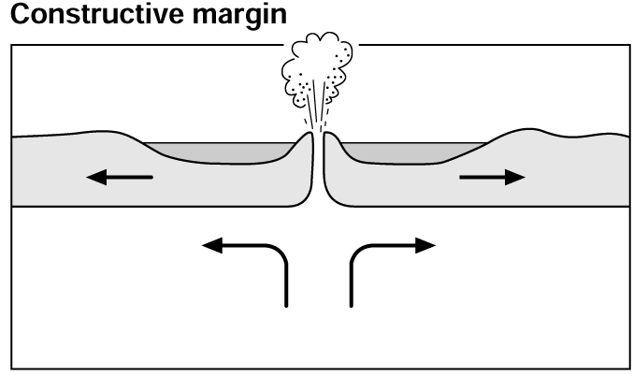
1-3 Mark Questions
The Challenge of Natural Hazards
Study figure 7, a tectonic plate margin. Identify the type of plate margin shown in figure 7. [1 mark]
Figure 7

Slide 18
1-3 Mark Questions
The Challenge of Natural Hazards
Study figure 7, a diagram to show the characteristics of a destructive plate margin. Suggest two tectonic hazards that are likely to occur at a constructive plate margin. [2 marks]
Figure 7

Slide 19
1-3 Mark Questions
The Challenge of Natural Hazards
Study figure 8, a world map showing tectonic plates and their direction of movement. With the help of figure 8, suggest one reason why Japan experiences more earthquakes that the UK. [2 mark]
Figure 8
UK
Japan

Slide 20
1-3 Mark Questions
The Challenge of Natural Hazards
Study figure 9, a table showing the five deadliest earthquakes since 1920.
Figure 9
Location | Year | Estimated death toll | Magnitude
Port-au-Prince, Haiti | 2010 | 316,000 | 7
Tangshan, China | 1976 | 242,769 | 7.5
Sumatra, Indonesia | 2004 | 227,899 | 9.1
Gansu, China | 1920 | 200,000 | 8.3
Tokyo, Japan | 1923 | 142,807 | 7.9
 | Total: | 1,129,475
The total number of deaths caused by the five deadliest earthquakes since 1920 is 1,129,475.
What percentage of the total number of deaths occurred in Port-au-Prince, Haiti? Give your answer to the nearest whole percentage. Show your working out.
[2 marks]

Slide 21
1-3 Mark Questions
The Challenge of Natural Hazards
Study figure 9, a table showing the five deadliest earthquakes since 1920.
Figure 9
Location | Year | Estimated death toll | Magnitude
Port-au-Prince, Haiti | 2010 | 316,000 | 7
Tangshan, China | 1976 | 242,769 | 7.5
Sumatra, Indonesia | 2004 | 227,899 | 9.1
Gansu, China | 1920 | 200,000 | 8.3
Tokyo, Japan | 1923 | 142,807 | 7.9
 | Total: | 1,129,475
Calculate the mean number of deaths caused by the five deadliest earthquakes since 1920. Give your answer to the nearest whole number. Show your working out.
[2 marks]

Slide 22
1-3 Mark Questions
The Challenge of Natural Hazards
Study figure 9, a table showing the five deadliest earthquakes since 1920.
Figure 9
Location | Year | Estimated death toll | Magnitude
Port-au-Prince, Haiti | 2010 | 316,000 | 7
Tangshan, China | 1976 | 242,769 | 7.5
Sumatra, Indonesia | 2004 | 227,899 | 9.1
Gansu, China | 1920 | 200,000 | 8.3
Tokyo, Japan | 1923 | 142,807 | 7.9
 | Total: | 1,129,475
Using figure 9 complete the graph by adding data for the earthquake in Tangshan, China.
[1 mark]

Slide 23
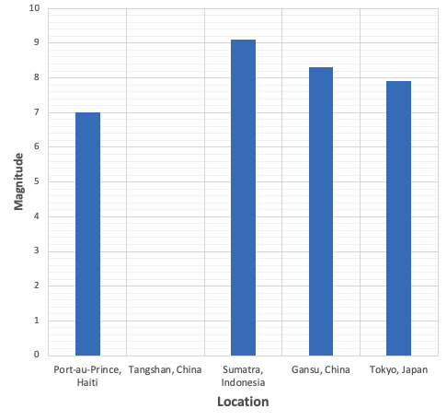
1-3 Mark Questions
The Challenge of Natural Hazards
A graph to show the magnitude of the five deadliest earthquakes since 1920

Slide 24
1-3 Mark Questions
The Challenge of Natural Hazards
Describe one way in which a region affected by earthquakes can prepare for
this hazard.
[2 marks]
Explain one difference between the type of volcanoes found at constructive
plate margins and those that occur along destructive plate margins.
[ 3 marks]
Suggest one reason by death rates caused by earthquakes in LICS/NEEs tend to be higher than in HICS.
[2 marks]
Outline one reason why people live in areas at risk from a tectonic hazard.
[2 marks]

Slide 25
1-3 Mark Questions
The Challenge of Natural Hazards
State two ways that planning might help to reduce the damaging effects of an
earthquake or a volcanic eruption.
[2 marks]
State two ways that protection might help to reduce the damaging effects of an
earthquake or a volcanic eruption.
[2 marks]
State two ways that monitoring might help to reduce the damaging effects of an earthquake or a volcanic eruption.
[2 marks]
Give one reason why predicting earthquakes is challenging.
[2 marks]

Slide 26
1-3 Mark Questions
Tropical
Storms

Slide 27
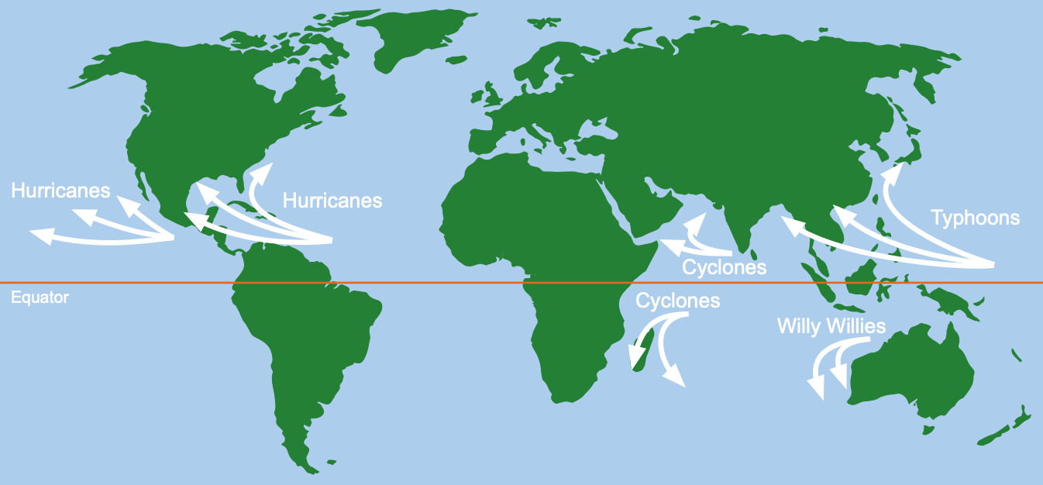
1-3 Mark Questions
The Challenge of Natural Hazards
Study figure 10 a map showing the distribution of tropical storms. Give two reasons why tropical storms form in the areas shown in Figure 3.
[2 marks]
Figure 10

Slide 28
1-3 Mark Questions
The Challenge of Natural Hazards
Study figure 10 a map showing the distribution of tropical storms. Suggest one way the distribution of tropical storms could change if global ocean temperatures continue to rise.
[1 mark]
Figure 10

Slide 29
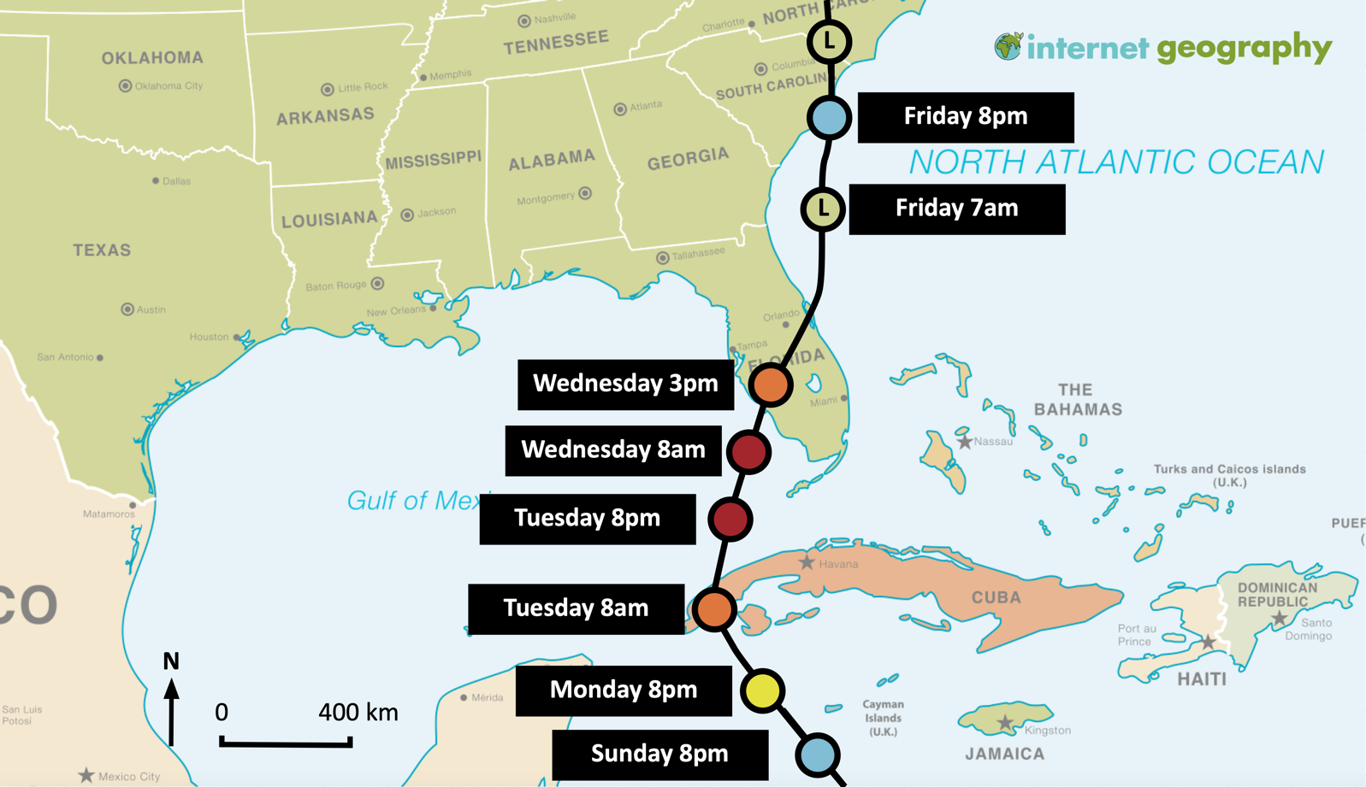
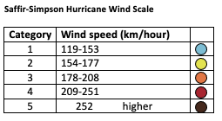
1-3 Mark Questions
The Challenge of Natural Hazards
Study figure 11, a map showing the track of Hurricane Ian from Sunday 25th September 2022. Describe the track of Hurricane Ian between 25th and 30th September. [2 marks]
Figure 11

Slide 30
1-3 Mark Questions
The Challenge of Natural Hazards
Using Figure 11, describe what happened to the wind speed of Hurricane Ian between Tuesday and Wednesday? [1 mark]
Figure 11

Slide 31
1-3 Mark Questions
The Challenge of Natural Hazards
Using Figure 11, state the wind speed of Hurricane Ian over Cuba.
[1 mark]
Figure 11

Slide 32
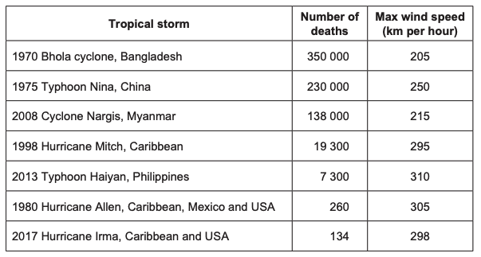
1-3 Mark Questions
The Challenge of Natural Hazards
Study figure 12, a table listing some of the most severe tropical storms of the past 50 years.
Figure 12
‘As maximum wind speeds increase, so does the number of deaths linked to tropical storms.’ Do you agree?
Use evidence from Figure 12 to support your answer.
[2 marks]

Slide 33
1-3 Mark Questions
The Challenge of Natural Hazards
Study figure 12, a table listing some of the most severe tropical storms of the past 50 years.
Figure 12
 | Number of Deaths | Maximum wind speed (km per hour)
1970 Bhola cyclone, Bangladesh | 350000 | 205
1975 Typhoon Nina, China | 230000 | 250
2008 Cyclone Nargis, Myanmar | 138000 | 215
1998 Hurricane Mitch, Caribbean | 19300 | 295
2013 Typhoon Haiyan, Philippines | 7300 | 310
1980 Hurricane Allen, Caribbean, Mexico and USA | 260 | 305
2017 Hurricane Irma, Caribbean and USA | 134 | 298
Total | 744994
The total number of deaths caused by the five deadliest tropical storms over the past 50 years.
What percentage of the total number of deaths occurred as the result of the Bhola cyclone, Bangladesh? Give your answer to the nearest whole percentage. Show your working out.
[2 marks]

Slide 34
1-3 Mark Questions
The Challenge of Natural Hazards
Study figure 12, a table showing the five deadliest tropical storms of the past 50 years.
Figure 13
 | Number of Deaths | Maximum wind speed (km per hour)
1970 Bhola cyclone, Bangladesh | 350000 | 205
1975 Typhoon Nina, China | 230000 | 250
2008 Cyclone Nargis, Myanmar | 138000 | 215
1998 Hurricane Mitch, Caribbean | 19300 | 295
2013 Typhoon Haiyan, Philippines | 7300 | 310
1980 Hurricane Allen, Caribbean, Mexico and USA | 260 | 305
2017 Hurricane Irma, Caribbean and USA | 134 | 298
Using figure 12 complete the graph by adding data for the tropical storm in Typhoon Nina in 1975.
[1 mark]

Slide 35
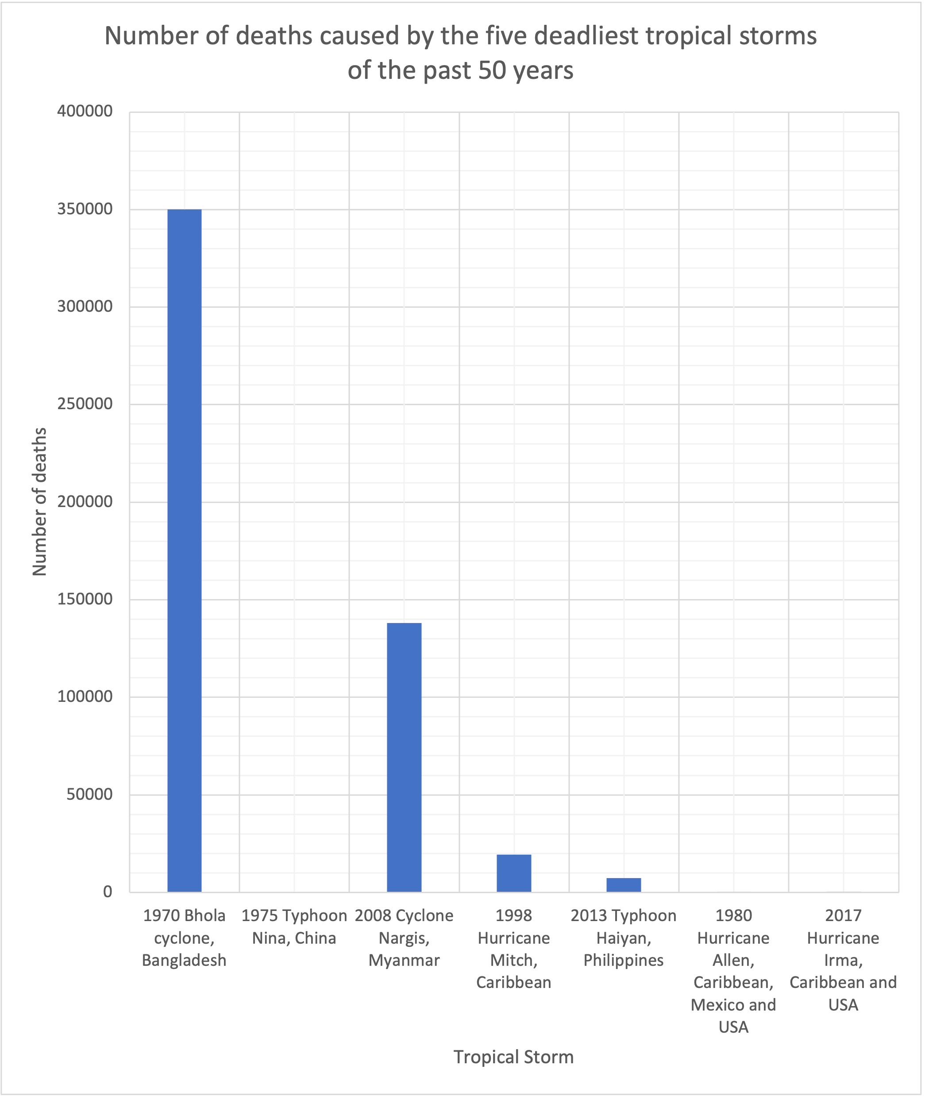
1-3 Mark Questions
The Challenge of Natural Hazards
A graph to show the number of deaths caused by the five deadliest tropical storms of the past 50 years

Slide 36
1-3 Mark Questions
The Challenge of Natural Hazards
Figure 14 below shows the deaths caused by the five deadliest tropical storms of the past 50 years
Figure 14
Give one limitation of using this type of graph to present the data.
[2 marks]

Slide 37
1-3 Mark Questions
The Challenge of Natural Hazards
Give one reason why the wind speed of a tropical storm (hurricane) may increase over open water. [1 mark]
Give one reason why the wind speed of a tropical storm (hurricane) may decrease over land. [1 mark]
Outline two conditions in which tropical storms form. [2 marks]
Give one reason why tropical storms have a seasonal pattern. [1 mark]
Describe one effect of a tropical storm. [2 marks]
Describe one way people can prepare for a tropical storm [2 marks]
State two ways in which climate change might affect tropical storms. [2 marks]

Slide 38
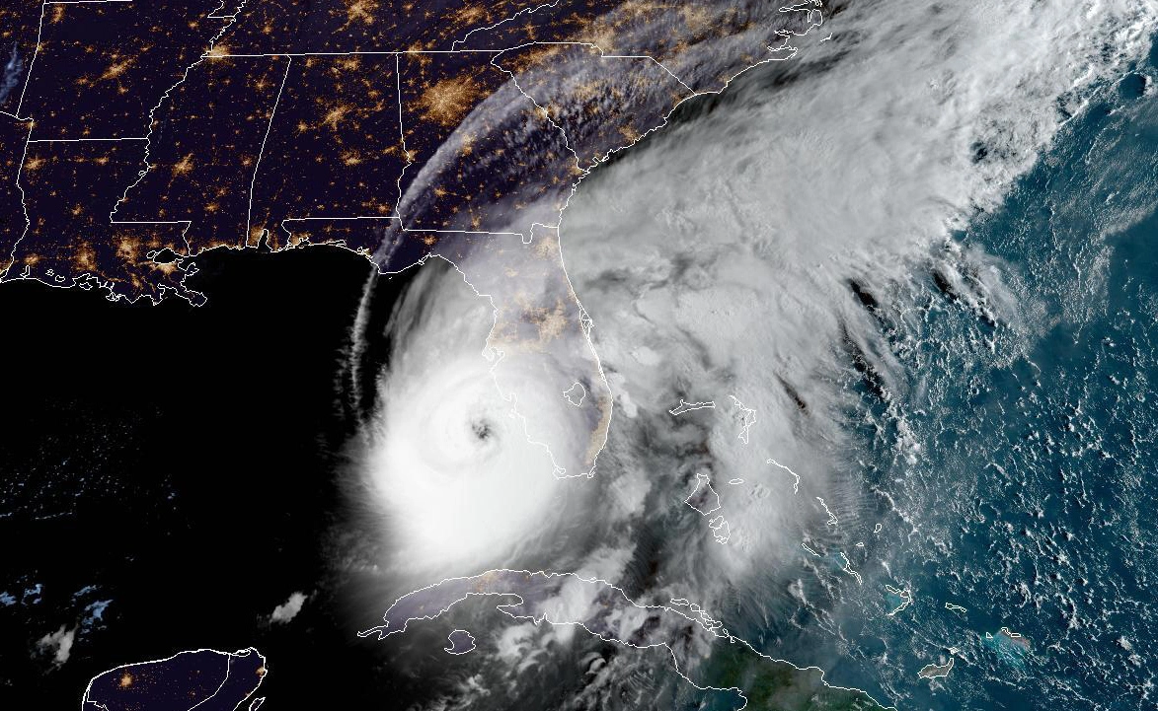
1-3 Mark Questions
The Challenge of Natural Hazards
Study Figure 15, a satellite image showing Hurricane Ian making landfall in the USA in September 2022.
Figure 15
Describe the structure of Hurricane Ian shown in Figure 15. [2 marks]

Slide 39
1-3 Mark Questions
Global
Atmospheric
Circulation

Slide 40
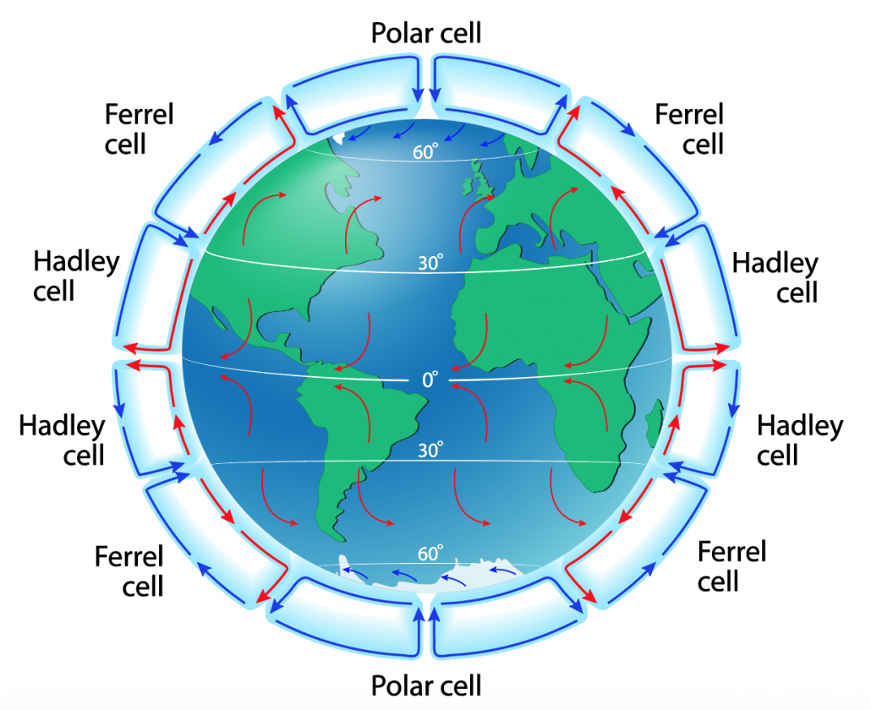
1-3 Mark Questions
The Challenge of Natural Hazards
Study figure 16, a diagram showing the main features of global atmospheric circulation.
Figure 16
Using figure 16, explain why there is low pressure at the equator. [2 marks]

Slide 41
1-3 Mark Questions
The Challenge of Natural Hazards
Study figure 16, a diagram showing the main features of global atmospheric circulation.
Figure 16
Using figure 16, describe the link between air pressure and surface winds.
[2 marks]

Slide 42
1-3 Mark Questions
The Challenge of Natural Hazards
Study figure 16, a diagram showing the main features of global atmospheric circulation.
Figure 16
Suggest why areas close to the Equator usually have high rainfall.
Use figure 16 and your own understanding. [2 marks]

Slide 43
1-3 Mark Questions
The Challenge of Natural Hazards
Study figure 16, a diagram showing the main features of global atmospheric circulation.
Figure 16
Using figure 16, explain why there is high pressure at 30° north and south of the
Equator.
[2 marks]

Slide 44
1-3 Mark Questions
The Challenge of Natural Hazards
Study figure 16, a diagram showing the main features of global atmospheric circulation.
Figure 16
Suggest why areas close to 30° north and south of the Equator usually have low rainfall. Use figure 16 and your own understanding.
[2 marks]

Slide 45
1-3 Mark Questions
The Challenge of Natural Hazards
Study figure 16, a diagram showing the main features of global atmospheric circulation.
Figure 16
Using figure 16, explain one effect of global atmospheric circulation. [2 marks]

Slide 46
1-3 Mark Questions
Climate
Change

Slide 47
1-3 Mark Questions
The Challenge of Natural Hazards
State what is meant by climate change.
[1 mark]

Slide 48
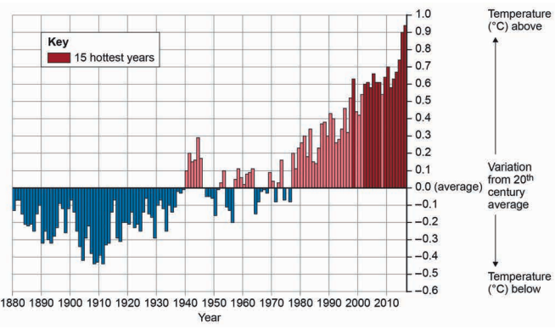
1-3 Mark Questions
The Challenge of Natural Hazards
Study figure 17, a graph showing variation in average global temperatures, 1880-2017. Give one natural cause of changes in global temperatures. [1 mark]
Figure 17

Slide 49
1-3 Mark Questions
The Challenge of Natural Hazards
Study figure 17, a graph showing variation in average global temperatures, 1880-2017. Give one human cause of changes in global temperatures. [1 mark]
Figure 17

Slide 50
1-3 Mark Questions
The Challenge of Natural Hazards
Describe one way in which volcanic eruptions can affect climate change.
[2 marks]
Describe one way in which solar output can affect climate change.
[2 marks]
Describe one way in which orbital changes can affect climate change.
[2 marks]
Describe one way in which the use of fossil fuels can affect climate change.
[2 marks]
Describe one way in which agriculture can affect climate change.
[2 marks]
Describe one way in which deforestation can affect climate change.
[2 marks]

Slide 51
1-3 Mark Questions
The Challenge of Natural Hazards
Give two pieces of evidence that show climate change is occurring.
[2 marks]
Explain how alternative energy production may help to reduce the rate of climate change.
[2 marks]
Explain how planting trees may help to reduce the rate of climate change.
[2 marks]
Explain how carbon capture may help to reduce the rate of climate change.
[2 marks]
Explain how international agreements may help to reduce the rate of climate change.
[2 marks]

Slide 52
1-3 Mark Questions
The Challenge of Natural Hazards
Outline one difference between climate change mitigation and adaptation.
[2 marks]
Explain how changes in agricultural systems may help to reduce the impact of climate change.
[2 marks]
Explain how managing water supplies may help to reduce the impact of climate change.
[2 marks]
Explain how reducing risk may help to reduce the impact of climate change.
[2 marks]

Slide 53
1-3 Mark Questions
The Challenge of Natural Hazards
State two forms of mitigation to manage climate change.
[2 marks]
State two forms of adaptation to manage climate change.
[2 marks]

Slide 54
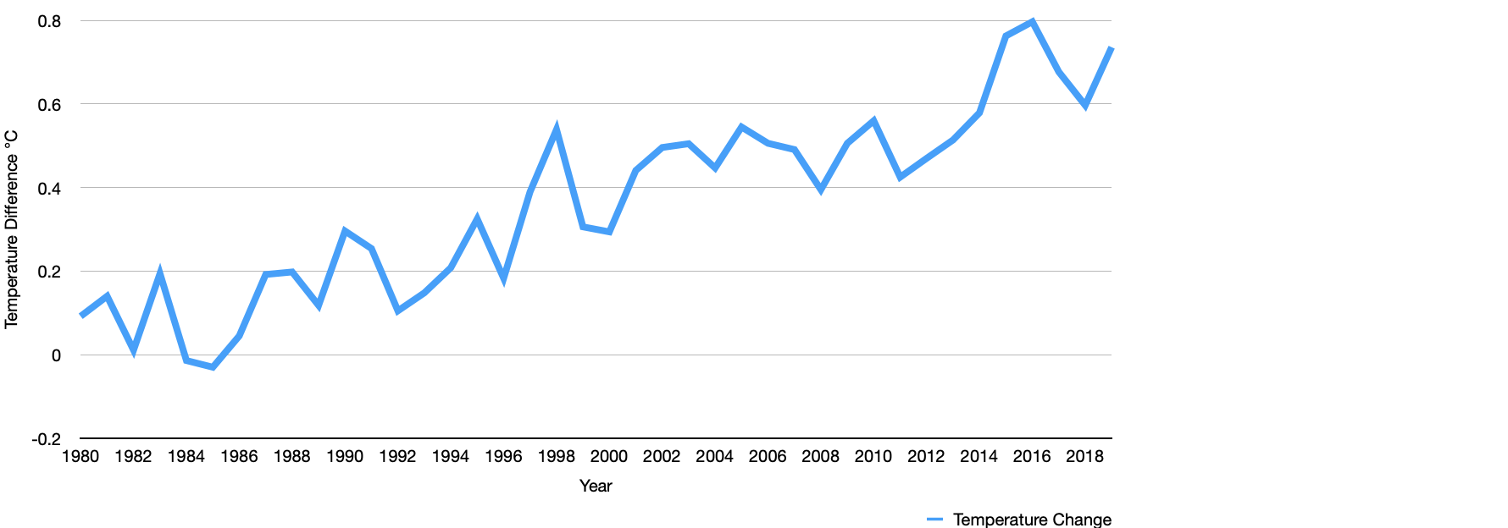
1-3 Mark Questions
The Challenge of Natural Hazards
Study figure 18, a graph showing variation in average global temperatures, 1980-2019. In 1980 global temperatures were 0.09 degrees higher than average. In 2019 global temperatures were 0.73 degrees higher than average. Calculate the percentage increase in average temperatures between 1980 and 2019. Show your working out.
[2 marks]
Figure 18

Slide 55
1-3 Mark Questions
UK Weather Hazards

Slide 56
1-3 Mark Questions
The Challenge of Natural Hazards
State what is meant by extreme weather.
[1 mark]
Give one example of a weather hazard that affects the UK.
[1 mark]
Give one example of a weather hazard that affects the UK.
[1 mark]
Give one piece of evidence to support the argument that the UK’s climate is getting more extreme.
[2 marks]
Give one prediction for future UK weather.
[1 marks]

