Slide 1
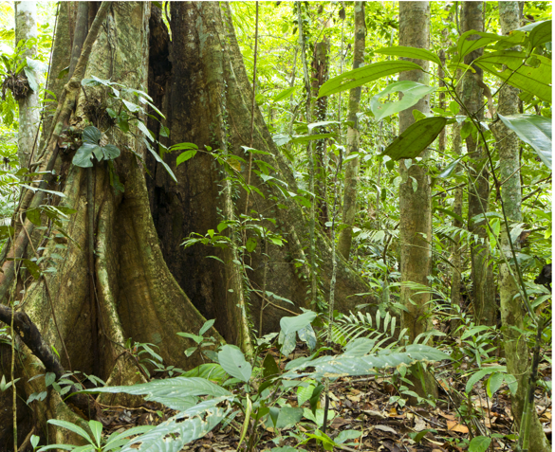
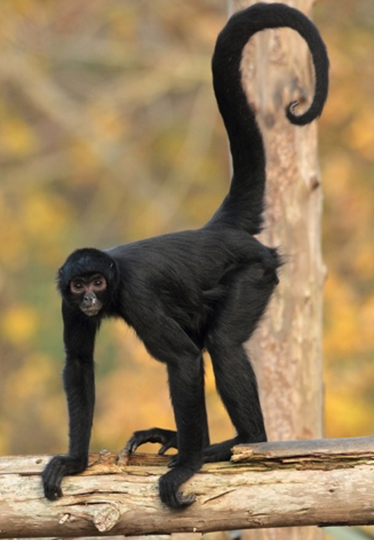
TRF Adaptations
Re-Write it
Read the Student answer to the question below.
Q. Plants and animals have adapted to survive in the tropical rainforest ecosystem. Using Figure 1 and your own knowledge explain this statement. (6 marks)
A. Figure 1 shows large wide buttress roots. There are also vines climbing the trees. Leaves are wide and waxy and have drip tips. The bark on the trees is thin and smooth. The spider monkey has a prehensile tail and long fingers and toes.
Rainforest vegetation
Spider monkey
Figure 1. Plants and animals in the tropical rainforest
Read the marking guidance to the question below then identify the positive features and suggest improvements that could be made.
Level | Marks | Description
3 (Detailed) | 5-6 | AO2 Shows thorough geographical understanding of the ways that plants and animals survive in the tropical rainforest. AO4 Demonstrates relevant and effective use of photographic evidence of plant and animal adaptations.
2 (Clear) | 3-4 | AO2 Shows some geographical understanding of the ways that plants and/or animals survive in the tropical rainforest. AO4 Demonstrates reasonable use of photographic evidence of plant and/or animal adaptations.
1 (Basic) | 1-2 | AO2 Shows limited geographical understanding of the ways that plants and/or animals survive in the tropical rainforest AO4 Demonstrates limited use of photographic evidence of plant and/or animal adaptations.
 | 0 | No relevant content
The command word “explain” is used, which means to provide a reasoned account of the ways that animals and plants adapt to the tropical rainforest.
Improvements
Positive
Identify key geographical terms that Should be included to improve the answer.
Glossary

Slide 2
TRF Adaptations
Re-Write it
Attempt the question below yourself. Write like a geographer – use key geographical terms and make sure you Explain (give reasons for) your answer.
Plants and animals have adapted to survive in the tropical rainforest ecosystem. Using Figure 1 and your own knowledge explain this statement. (6 marks)
Figure 1. Plants and animals in the tropical rainforest

Slide 3
TRF Adaptations
Re-Write it
Attempt the question below yourself. Write like a geographer – use key geographical terms and make sure you Explain (give reasons for) your answer.
Plants and animals have adapted to survive in the tropical rainforest ecosystem. Using Figure 1 and your own knowledge explain this statement. (6 marks)
Figure 1. Plants and animals in the tropical rainforest
Some rainforest trees, such as those in figure 1, have buttress roots as they grow incredible tall (over 50 m in some cases) as there is great competition for sunlight. As you can see in figure 1 some plants, such as
lianas, climb up the trees to reach sunlight for photosynthesis because very light travels through the canopy,
while others live on branches in the canopy for the same reason i.e. epiphytes. The bark on the trees in figure 1 is thin and smooth to allow free flow of water and because the high temperatures mean that there is no
need for protection against cold. Due to the high rainfall, leaves on plants like those shown in figure 1 often have drip tips which allow the water to be channelled to the end and fall so the leaf does not break. Leaf stems are also flexible to allow leaves to move with the sun.
The spider monkey in figure 1 has a prehensile tail. The prehensile tail allows the spider monkey to be
able to grasp the branches of rainforest trees. The monkey can hang by its tail, swing by it, pick fruit in
the canopy, where it spends most of its time. The poison dart frog is known for its bright colour;
however, in the animal world, this signifies dangers. The poison dart excretes poison through its skin,
and its bright colour warns potential predators against eating it. Some of the frogs in this family are not
poisonous. However, they have adapted to their environment by copying the appearance of the toxic
types.

