Slide 1
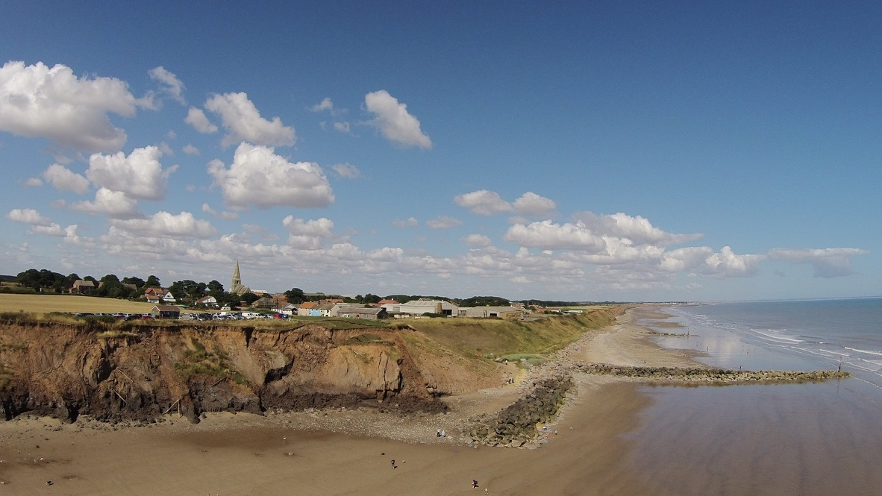
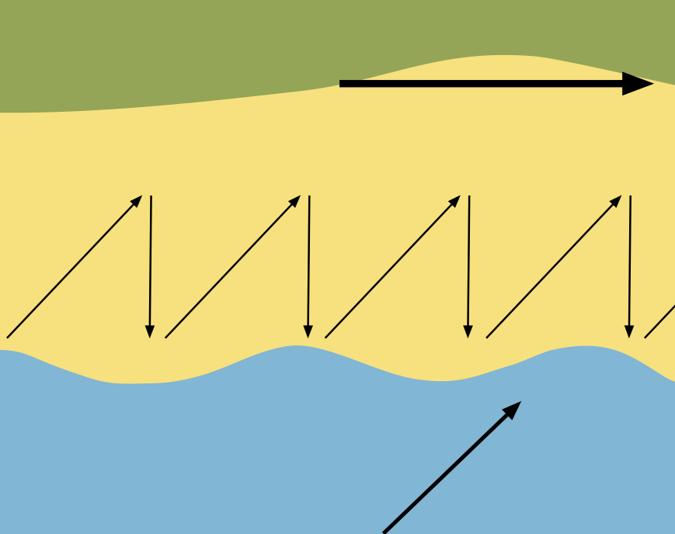
Explain the cause of waves.
Give three characteristics of a destructive wave.
Explain how hydraulic action causes coastal erosion.
Explain how material is transported
by traction.
Annotate the diagram below to explain longshore drift.
Explain the mass movement process of slumping.
Label the main features of the headland shown below.
Identify the landforms commonly found on or close to headlands.
Explain the formation of coastal bars.
Identify three hard engineering coastal management strategies.
Discuss the negative impact of coastal management at Mappleton using the image above.
What are the social, economic and environmental costs of a sea wall?
Coastal environments
QUIZZES

Slide 2
Waves are caused by energy transfer from the wind to the sea. As the wind blows over the surface of the sea, it creates friction forming waves. In deep water, water molecules within a wave move in a circular movement. It is only in shallow areas that the water itself moves forward.
Short wave-length, so a high frequency (10-14 waves per minute)
Steep wave front
Wave plunges onto steep beach
Weak swash
Strong backwash
Hydraulic action is the force of waves crashing against a cliff or other rocky coastline compresses air in cracks and crevices. When the wave retreats, the compressed air explosively decompresses, acting like a small jackhammer on the rock. Over time, this can cause rocks to break and cliff collapse.
Traction is when larger particles like boulders and pebbles are rolled along the sea floor (or riverbed). These particles are too heavy to be carried in suspension. Instead, the force of the water rolls or drags them along the bottom.
Annotate the diagram below to explain longshore drift.
Slumping involves a rotational movement of material along a concave slip plane. The top of the slump often tilts back, creating a ‘bench’, while the bottom of the slump pushes forward to form a ‘toe’. Slumps are often triggered by heavy rain, causing saturation of the material, or by erosion at the base of a slope.
Material is transported up the beach at an angle.
Direction of material being transported by longshore drift
Backwash – wave retreats down the beach at a right-angle due to gravity, transporting beach material.
Swash – waves moving up the beach, at an angle determined by the prevailing wind.
Label the main features of the headland shown below.
Prevailing wind
Cracks, caves, arches, stacks, stumps, wave-cut notches and wave-cut platforms.
crack
cave
arch
stack
stump
A bar is a depositional landform that runs parallel to the coast, connecting two headlands and enclosing a body of water behind it, forming a lagoon. Bars form when a spit grows across a bay or when there is significant sediment transportation by longshore drift and deposition.
Sea walls, groynes, rock armour, rip-rap, revetments, and gabions.
Rock groynes trap sediment transported by longshore drift. Sediment transported away down-drift of the defences is not replaced resulting in a very low beach. Waves are able to reach the base of the boulder clay cliffs even during neap times, increasing the rate of erosion.
Social
Sea walls can restrict access to the beach
Coastal flooding occurs when waves overtop
Economic
They are expensive to construct and maintain
Reflected waves scour the beach and cause foundations to be undermined
Environmental
They destroy natural habitats
Reduce sediment input to the coastal system
They do not look attractive
Coastal environments
QUIZZES

