Slide 1
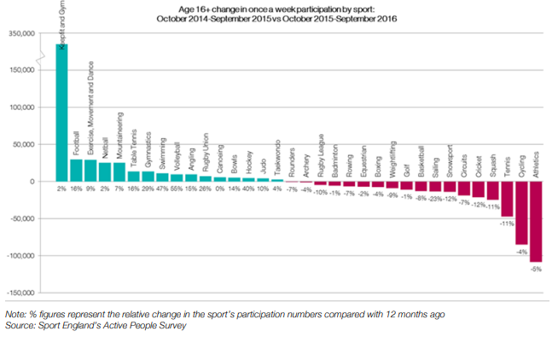
GCSE PE Unit 2: Engagement Patterns ^{Year: Half Term:}
ONE: Key Vocabulary
Word | Definition
Ethnicity | A state of belonging to a specific social group with common cultural or national traditions or beliefs.
Gender | The state of being male or female.
Role models | Someone to be looked up to, (good role model) an example to follow.
School | Due to bad PE experience at school/ unpleasant showers/ kit/ changing facilities
Low esteem | Low esteem/ lack of confidence/ they don’t think they are good enough/ fear of failure/embarrassment/ body consciousness
Religion | Some ethnic groups don’t encourage sport for women
Attitudes | Fear among that they may be perceived as homosexual, attitude that sport is for males/ stereotyping
Peers | Peer pressure/friends don’t participate
Community | Inadequate choice or provision or opportunity / eg lack of clubs/ lack of female sports leaders
Discrimination | The unfair treatment of individuals whereby opportunities are not available to all of the different social groups.
TWO: Core Questions
Question | Answer
Describe the engagement patterns of the social group: Gender | Women have more body fat upto 30% more, women have 2/3 of the strength of men, flexibility tends to be greater in women, boys overtake women in height, weight and strength
Describe the engagement patterns of the social group: Age | Reaction time descreases as you get older, strength increases with age until 30s, young children cannot cope with difficult tasks, injury and disease are more common as you get older
Describe the engagement patterns of the social group: Disability | Adapted activities, adapted equipment, disability classifications, provision
Identify a range of factors that can affect engagement | Attitudes, role models, education, media coverage, familiarity, income, inclusiveness, religion, sexism, family commitments
Describe the engagement patterns of the social group: Family/friends | Peers may encourage you or discourage you from participation, parents often pay for travel, memberships, costs, peer pressure
Describe the engagement patterns of the social group: Race/religion/culture | Womens boxing, single se rules in sport, dress codes, head and hair codes e.g. Sikh faith, religious dietary guidelines
THREE: …

Slide 2
GCSE PE Unit 2: Commercialisation ^{Year: Half Term:}
ONE: Key Vocabulary
Word | Definition
Commercialisation | Links business and commerce into sport with a primary focus of profit which can lead to exploitation. Using sport with the sole intent to make money from doing so.
Golden triangle | The links and relationship between sponsorship, sporting events and the media.
Media | Different forms of communication that can inform, educate and entertain people including social, internet, TV and newspapers.
Sponsorship | The giving of money or goods to performers in order to get good publicity and/or increase profit.
Unacceptable sponsorship | Sponsorship of sport when a sponsor's image or product appears to undermine the sporting message (e.g. tobacco, alcohol & fast food
Media pressure | The way the media may hound or intrude upon individuals.
Minority Sports | Lesser known sports with lower participation levels.
Sport | Players, teams, competitions, tournaments, events, coaches, transport
Role models | Someone to be looked up to, (good role model) an example to follow.
TWO: Core Questions
Question | Answer
What are the positive effects of sponsorship on the performer/sport? | Sponsorship deals, promotion, more prize money, improves profile and image of the sport
What are the negative effects of sponsorship on the performer/sport? | Withdrawal of sponsorship, change of dates of events, clothing and equipment restrictions, inequality
What are the positive effects of sponsorship for the sponsor? | Advertising, image, tax relief, research and development
What are the positive effects of the media on sport? | Promotes sport, raises popularity, increases participation, increased revenue, sponsorship, education
What are the negative affects of the media on sport? | Media pressure, TV directors influence, populairty, undermines officials, intrusion
How can the media impact sport? | Demonstrating performance and participation, Undermining officials, Encouraging variety Biased popularity, Edited coverage, Altered event timings, Limited attendance
THREE: …

Slide 3
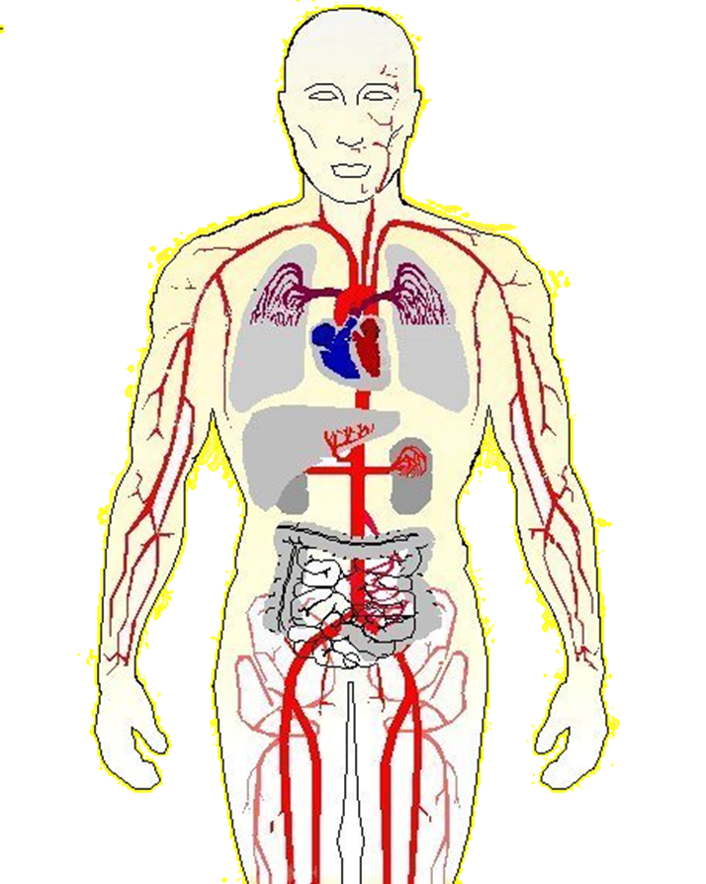
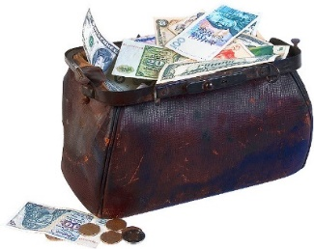
GCSE PE Unit 2: Ethical Issues ^{Year: Half Term:}
ONE: Key Vocabulary
Word | Definition
Beta Blockers | A drug used to control heart rhythm and lower blood pressure.
Discrimination | The unfair treatment of individuals whereby opportunities are not available to all of the different social groups.
Deviance | Behaviour that is either immoral or seriously breaks the rules and norms of the sport.
Gamesmanship | Where the laws of the game are interpreted in ways, which whilst not illegal, are not in the spirit of the game. Pushing the limits to gain unfair advantage.
Sportsmanship | Ethical, appropriate, polite and fair behaviour while participating in a game or athletic event; fair play.
Steroids | Anabolic steroids are synthetic hormones that enhance physical performance.
Stimulants | Drugs used to raise physiological arousal in the body
Violence | Physical acts committed in sport that go beyond the accepted rules of play or the expected levels of contact within a contact sport.
Etiquette | The unwritten rules concerning player behaviour
TWO: Core Questions
Question | Answer
What are the benefits & negatives of using stimulants? | Build muscle mass Death, high blood pressure, anxiety, strokes, irregular heartbeat, addiction
What are the benefits and negatives of using anabolic steroids? | Increase muscle strength, help them train longer and harder Liver damage, heart disease, addiction, aggression, sexual problems, kidney damage
What are the benefits and negatives of using beta blockers? | Reduce heart rate, muscle tension, and blood pressure, reduces affects of adrenaline, improve preciseness Nausea, weakness, heart problems
Are the following scenarios examples of violence or aggression/assertiveness? | A rugby player mistiming a tackle & tackling in the air A strong shoulder charge in football that sends the other player flying A spear tackle in rugby A bouncer in cricket that hits the batsman on the helmet Jostling for position in the 1500m and accidentally tripping another athlete A boxer punching an opponent after the bell
THREE: …

Slide 4
GCSE PE Unit 2: Sports Psychology ^{Year: Half Term:}
ONE: Key Vocabulary
Word | Definition
Closed skill | Skills that are performed in a predictable environment. E.g. a Player taking a line out in Rugby.
Complex skill | A skill which requires a lot of focus and decision making to perform.
Motor Skill? | Learned actions or learned behaviours with the intention of bringing about predetermined results
Feedback | Information that is given to a performer either during or after their performance with the aim of improving future performances.
Guidance | Given to aid the learning of a skill.
Mental preparation | The rehearsal of a physical skill that takes place within the mind of the performer without any actual physical movement.
Open skill | These are affected by the environment and are predominantly perceptual as they must be adapted to suit the environment. These skills are usually externally paced. E.g. a pass within a game situation in football.
Simple skill | Consists of basic movement actions that are not difficult to perform with few decisions to make. E.g. A chest pass, a straight up and down jump.
Skilful movement | A fluent and coordinated movement which is efficient, technically accurate and aesthetically pleasing.
Skills continua | A method of categorising skills along a continuum, classified according to their level of difficulty.
TWO: Core Questions
Question | Answer
Explain verbal guidance | This involves using your sense of hearing and could involve listening to a coach give instructions.
Explain visual guidance | This involves the performer being able to actually see something using sight which could be a demonstration, a video, you tube clip or photograph, chart, court markings.
Explain mechanical guidance | This involves the use of objects or aids such as RoboGolfPro machine for golfers to practice the golf swing, floats in swim.
Explain manual guidance | This is where the performer can be assisted in a physical movement e.g. supporting somebody do a gym vault.
Describe knowledge of results | This is feedback the performer gets through the end result of a performance e.g. the score, how many runs made
Describe knowledge of performance | This is how the performer feels about their actions from the performance that has just taken place
Describe what is meant by positive feedback | Feedback about what was good and correct about a performance
Describe what is meant by negative feedback | Feedback about what was bad or incorrect about a performance
THREE: …
Specific A specific goal, not a vague desire to improve Measurable There is standard to measure progress against Achievable The goal is agreed by both the performer and the coach Realistic It is possible to achieve Timed A specific time period gives the goal added focus Write your own SMART target: Specific: Measurable: Achievable: Realistic: Timed: What impact did this have?

Slide 5
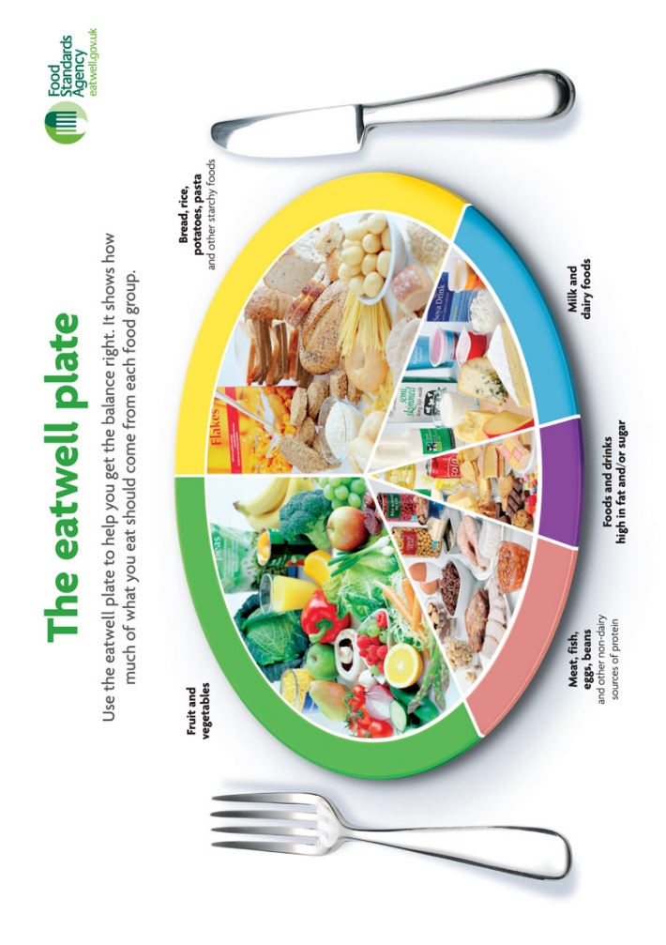
GCSE PE Unit 2: Health, Fitness & Well-Being ^{Year: Half Term:}
ONE: Key Vocabulary
Word | Definition
Balanced diet | A diet that contains the correct proportions of carbohydrates, fats, proteins, vitamins, minerals, and water necessary to maintain good health.
Energy balance | Energy input = energy expenditure. This equation must balance for your body weight to remain constant.
Exercise | Activity that requires physical effort. Usually carried out to sustain or bring about improvements to health or fitness.
Fitness | Your ability to meet the physical demands placed on you by the environment.
Health | The state of emotional, physical and social well-being.
Hydration | Having the appropriate level of water in the body for it to function optimally. When this level of water falls below optimal levels it is referred to as dehydration.
Obesity | The state of being very overweight, with a lot of excess body fat, usually classified using the BMI calculation of 30 or above.
Physical activity | Movement of the body by the skeletal muscles that requires energy expenditure.
Type 2 diabetes | A metabolic disorder that affects how your body handles glucose. Often associated with obesity and can be controlled through changes to your diet.
TWO: Core Questions
Question | Answer
Identify 5 reasons for having good physical health and well being | Improves efficiency of body systems, reduces risk of illnesses, able to do everyday tasks, helps avoid obesity, improves heart function
Identify 3 reasons for having good mental health and well being | Reduces stress/tension, able to control emotions, releases serotonin
Identify four reasons for having good social health and well being | Cooperation, teamwork, socialise, make friends
What is meant by a sedentary lifestyle and its consequences? | An inactive lifestyle, lack of regular exercise, Weight gain/obesity, heart disease, diabetes, lethargy, poor sleep, poor self esteem, hypertension
How can obesity affect performance, physical, mental and social health? | Lack of stamina, limits agility, flexibility, speed/power Heart disease, heart attacks, cancer, diabetes, Depression, poor self esteem/low confidence Inability to socialise
What is meant by carbo loading? | Eating foods that are high in starch to increase carbohydrate reserves in the muscles
THREE: …
Label the 7 components of a healthy diet: 50% carbohydrate 30-35% Fat 15-20% Protein

